Slide 1
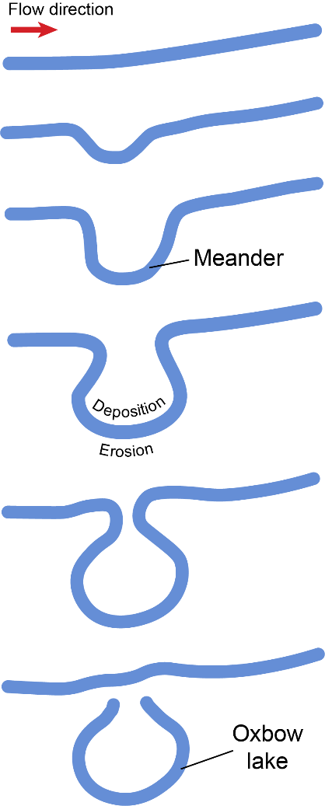
Evolution of a River’s Form
Notes:
Notes: Rivers never tend to travel in a completely straight line; their path usually curves and snakes. The curves of a river are called meanders. A river’s meanders will continue to grow curvier and curvier with time, as the river erodes along its outer curve and deposits along the inner curve. Eventually, the edges of a meander will get close enough to meet up with each other. The river will then take a new straighter, shorter path, leaving behind a crescent-shaped portion of the river called an oxbow lake. Over time oxbow lakes typically disappear due to sedimentation or subsequent river migration. This sequential evolution of a river’s form repeats over time

Slide 2
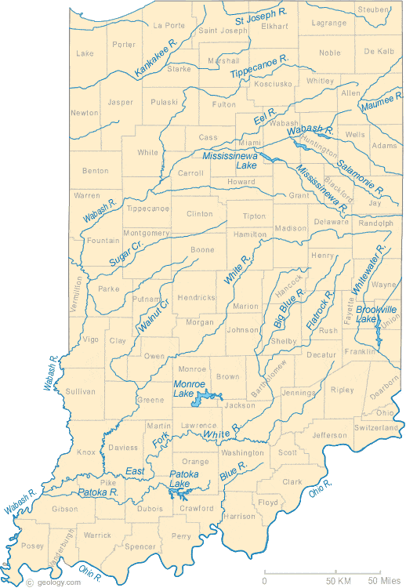
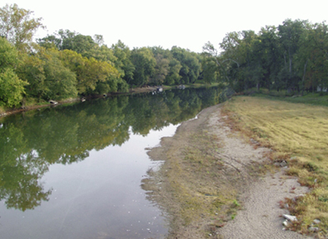
Map of Indiana Rivers
Indianapolis
White River in Hamilton County, IN. (Credit, USGS)
Notes:
Notes: Map of rivers in Indiana. Rivers in Indiana cross much of the state, primarily running from east to west. The two major rivers are the Wabash River and the White River. In this map, you can see the many tributaries of these main rivers.

Slide 3


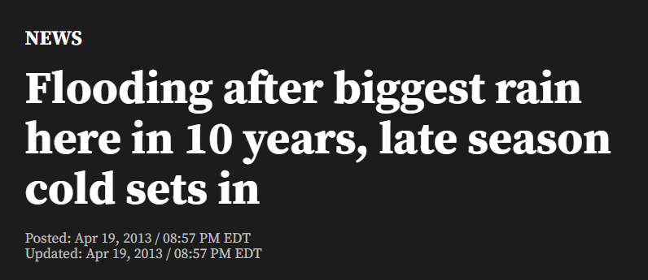
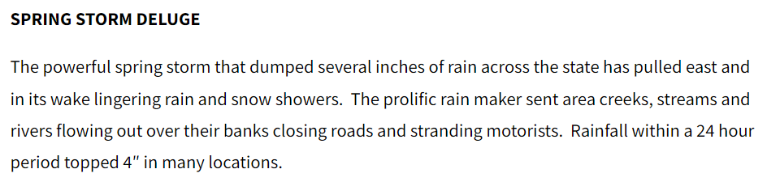
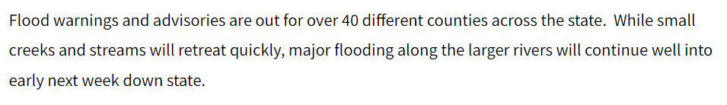
Notes:
Notes: Given the large extent of the state that rivers pass through, flooding can be a significant hazard in Indiana. Here is a news article from April 19, 2013 that describes significant flooding after a big rain storm. (https://fox59.com/news/flooding-after-biggest-rain-here-in-10-years-late-season-cold-sets-in/)

Slide 4

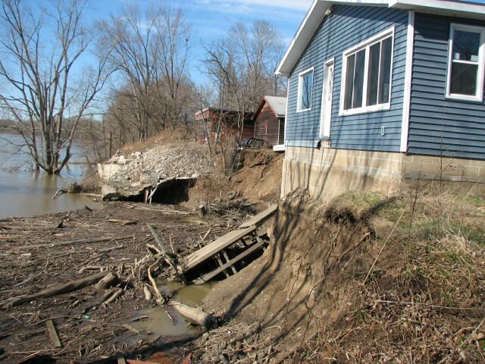
https://feh.iupui.edu/
Notes:
Notes: A home threatened by fluvial erosion on the Wabash River, Indiana (from Indiana’s Fluvial Erosion Hazard Program, *Image courtesy of the Indiana Department of Homeland Security). Rivers are dynamic landforms and naturally move and shift across the landscape with time. Houses and infrastructure are often built near rivers

Slide 5
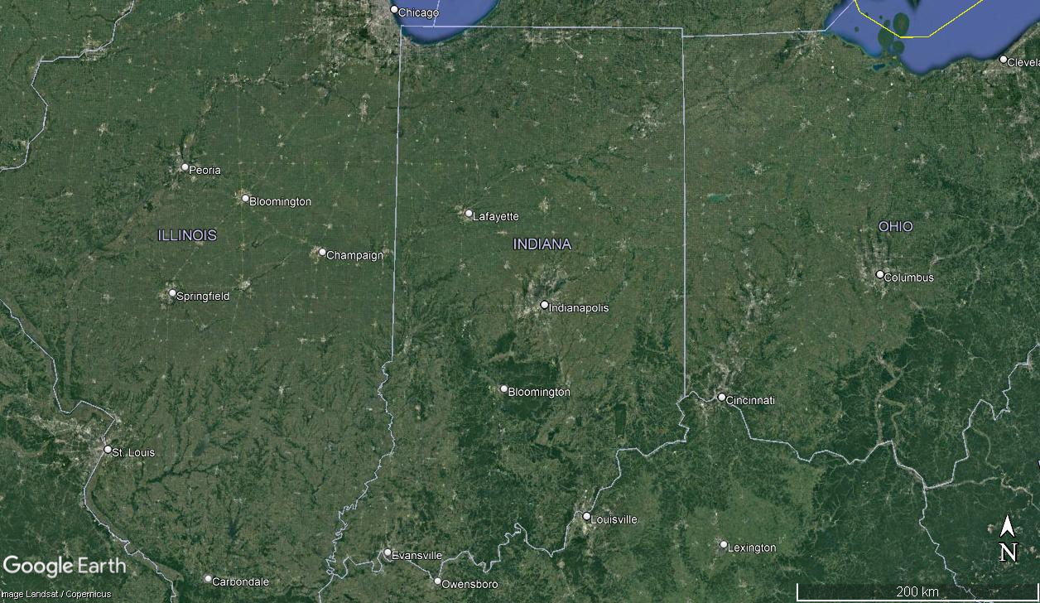
Notes:
Notes: Have students use Google Earth to look at the rivers in Indiana. Where are rivers located? (Urban rural). Is it easy to find the rivers? Are the features/colors of the landscape (vegetation and buildings) distracting when looking for rivers? Can you see evidence of ‘scars’ left in landscape from the river’s former paths? Do the rivers have very curvy meanders? Are they straight? etc.

Slide 6
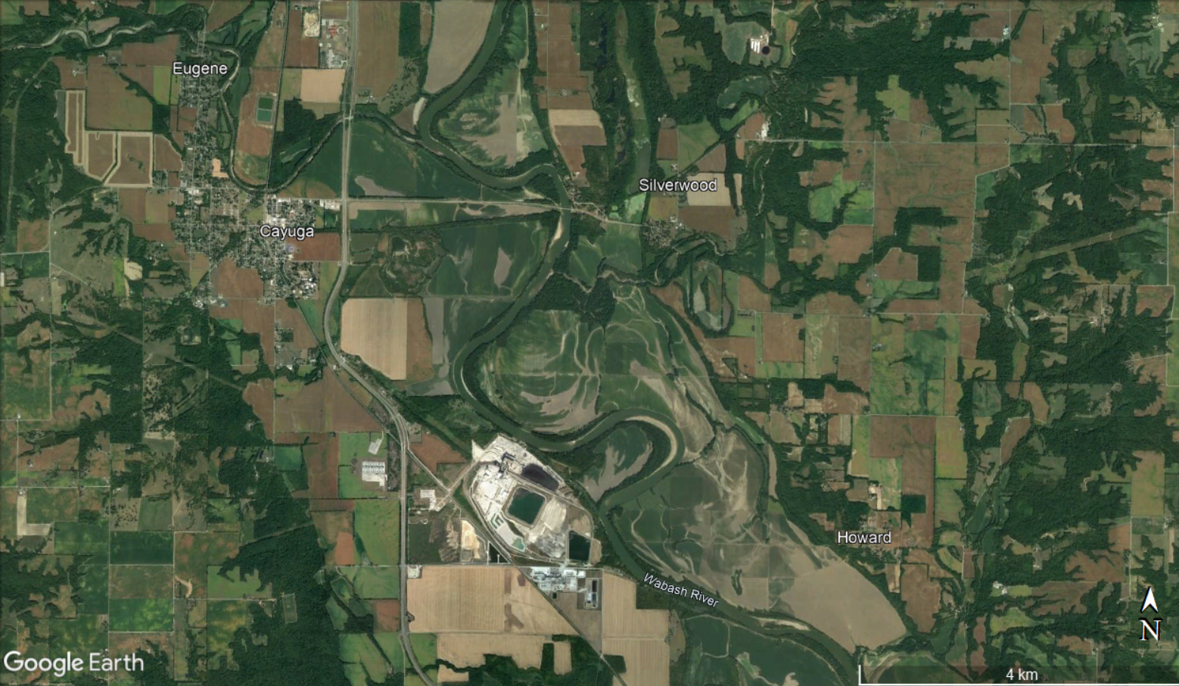
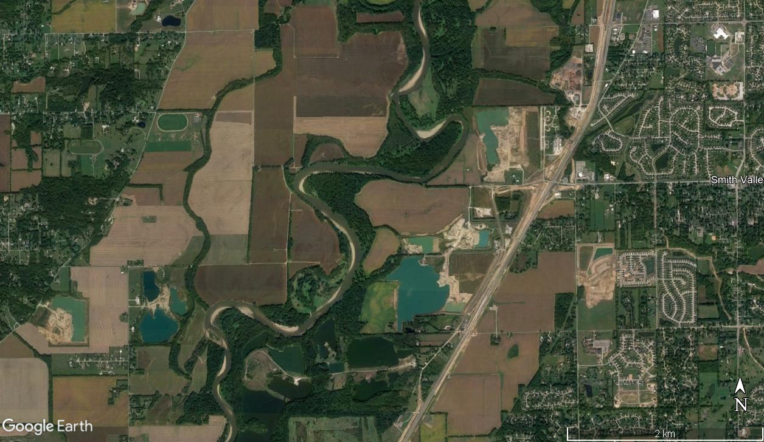
Notes:
Notes: Examples of Google Earth satellite imagery showing rivers in Indiana.

Slide 7
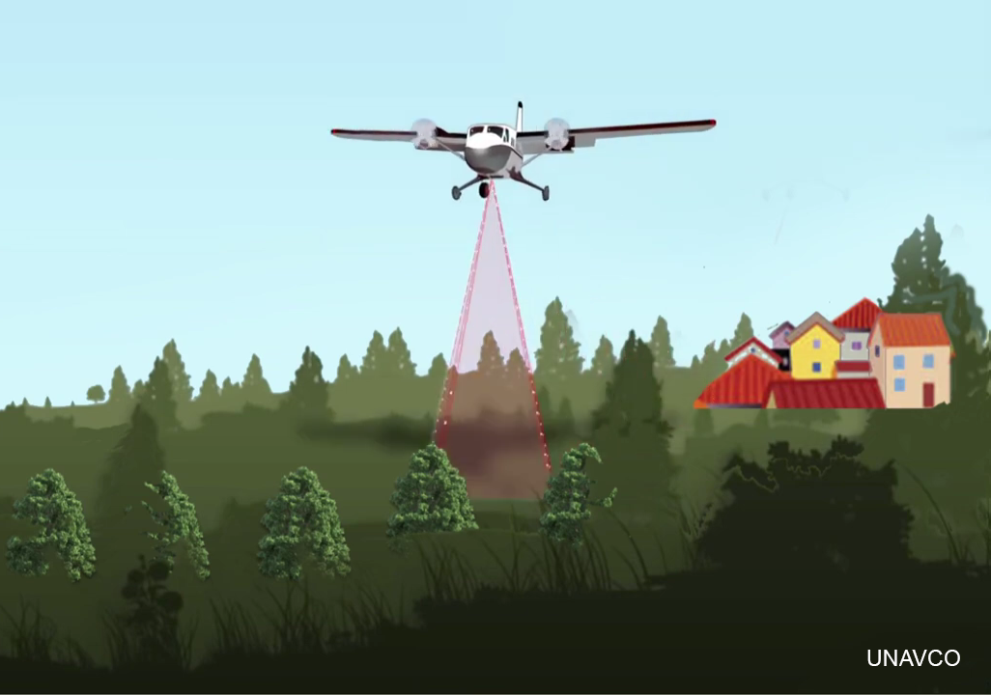
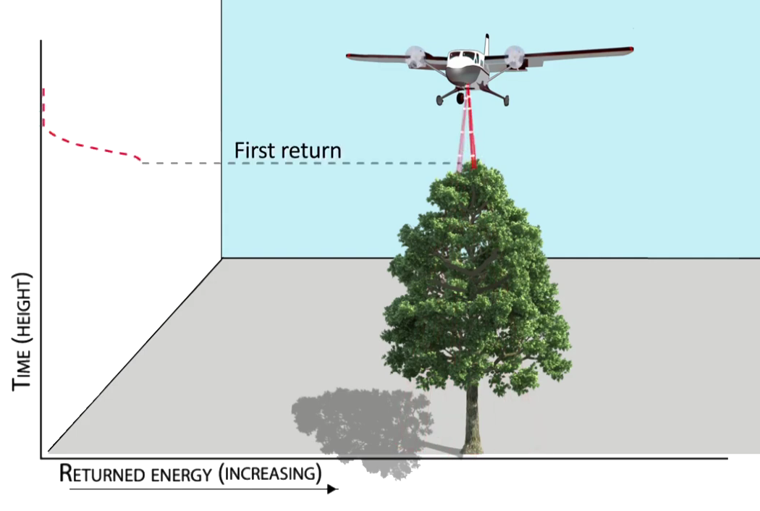
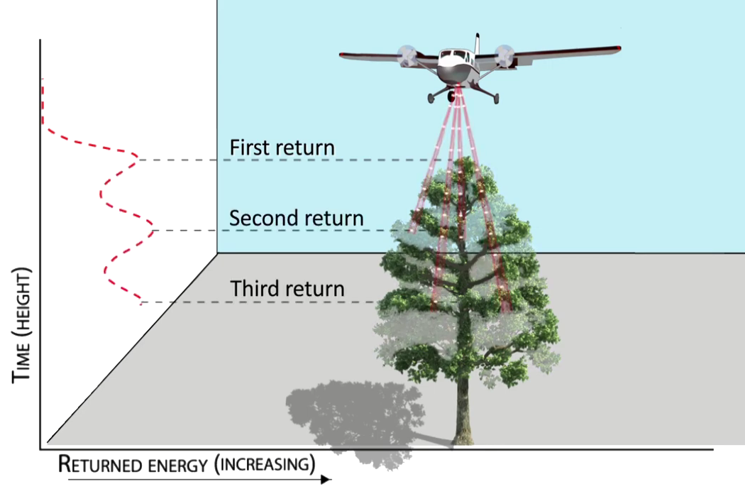
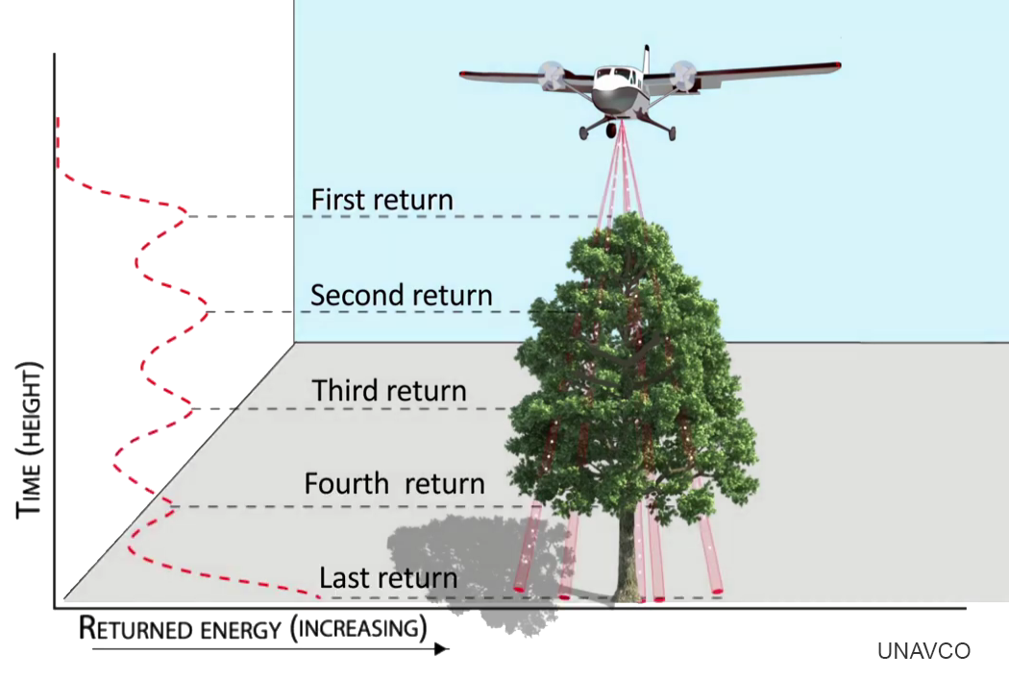
What is Lidar?
Light detection and ranging
Used to create high resolution three-dimensional representations of Earth's surface, including buildings, vegetation, and the ground
Notes:
Notes: Lidar stands for light detection and ranging. Lidar is a remote sensing method that uses laser light pulses to measure variable distances (aka ranges) to the Earth. Lidar is used to create high resolution three-dimensional representations of Earth's surface, including buildings, vegetation, and the ground. A single laser pulse can reflect off of multiple objects and surfaces as it travels to the ground. The first surface a pulse reflects off of is called the "first return." The first returns represent the uppermost surfaces in a landscape. Just as gaps in tree and forest canopy can let light through, the laser pulse can also pass through these gaps and bounce off intermediate returns on its way to the ground. The "last return" is typically at or near the ground surface. (see more at https://opentopography.org/lidar_basics)

Slide 8
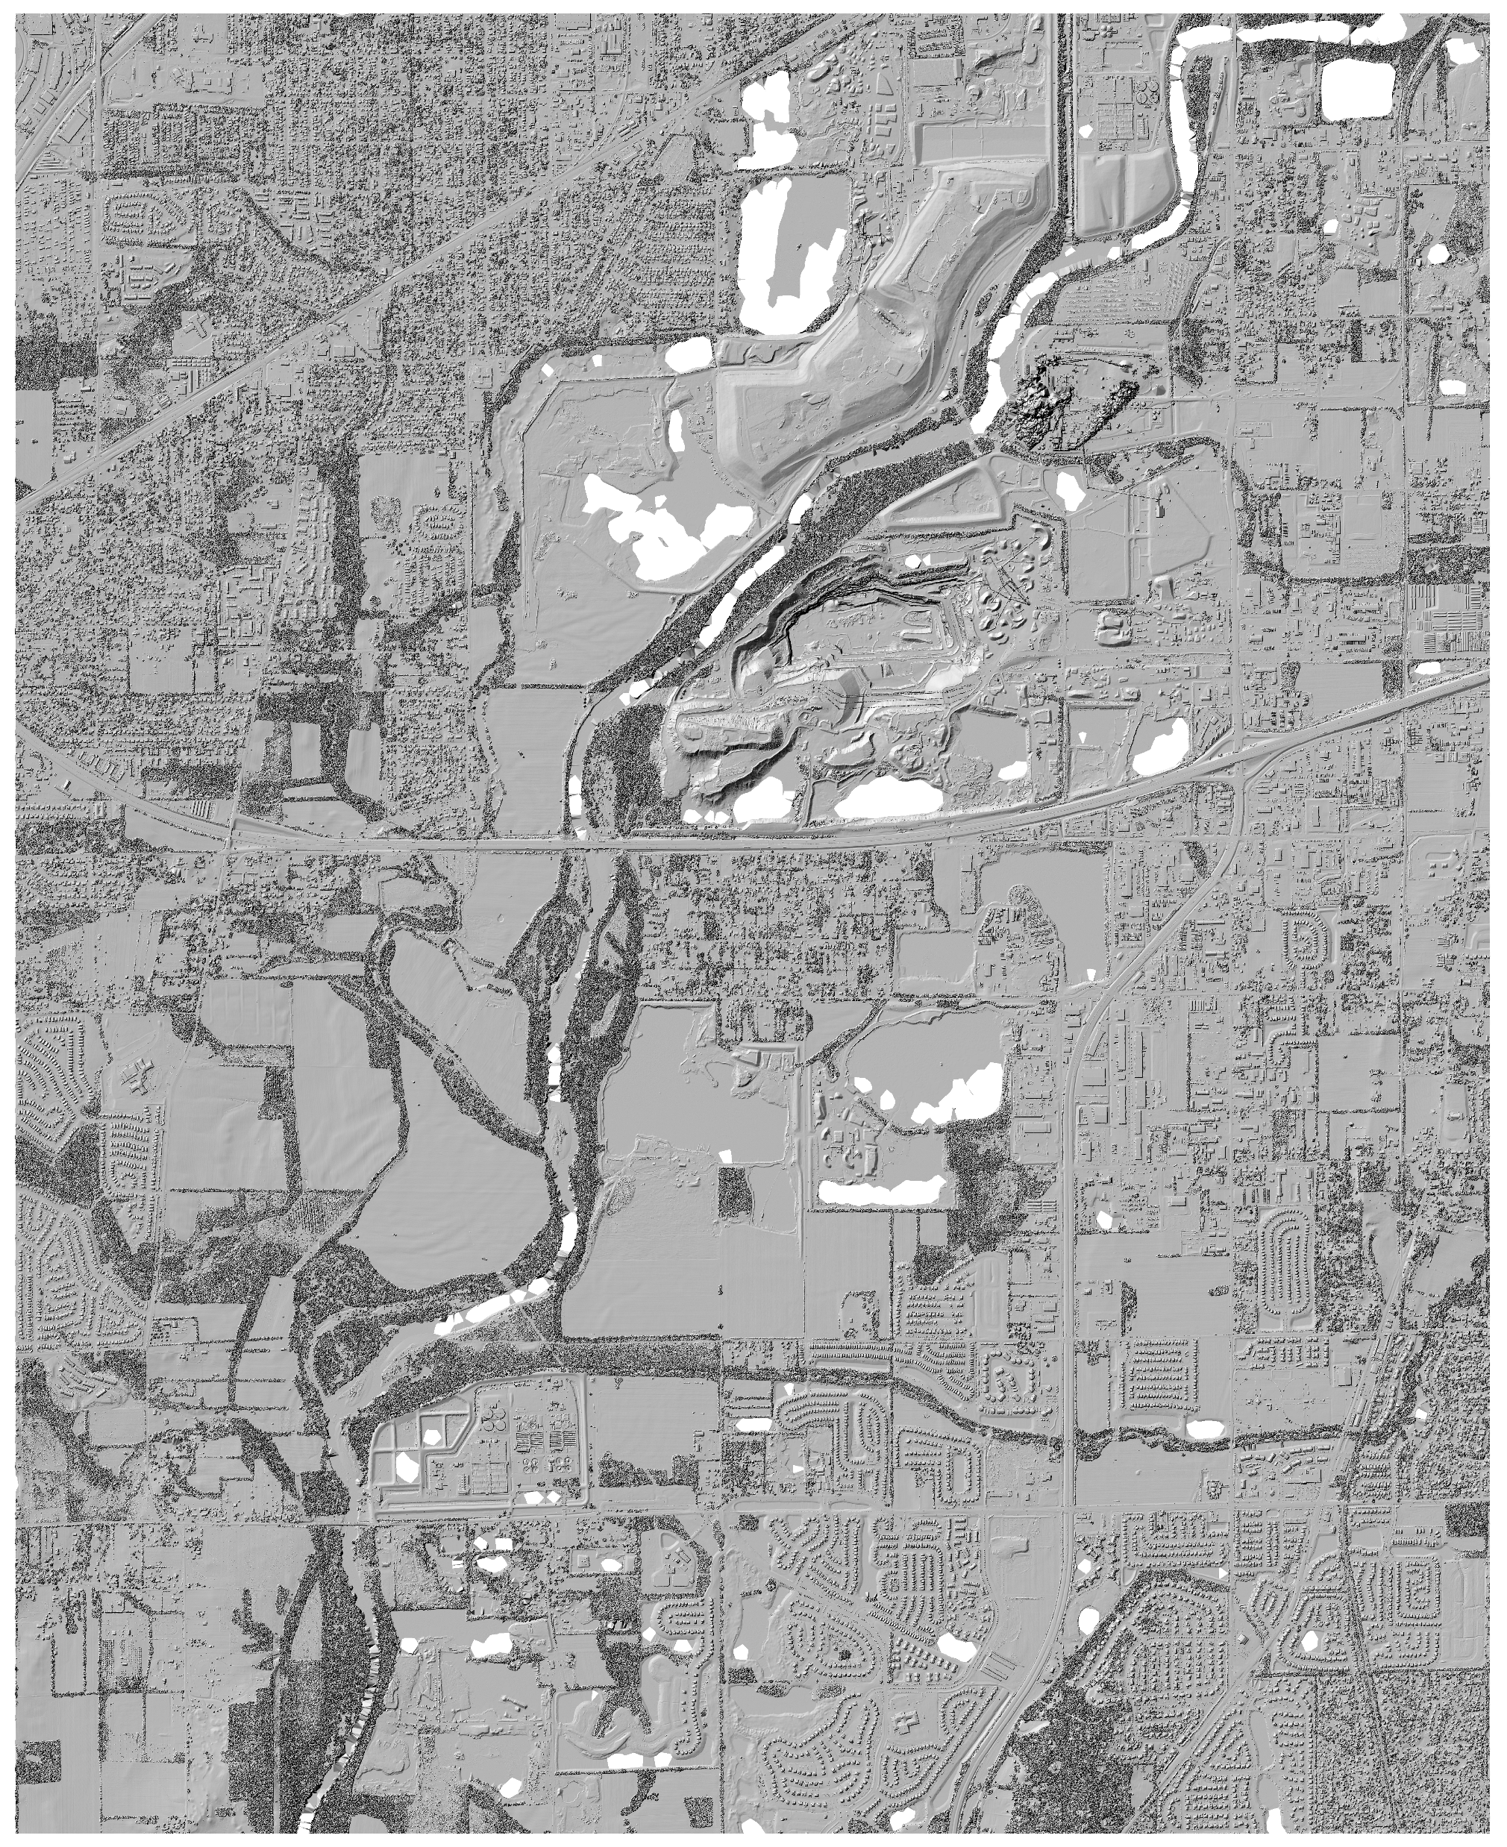
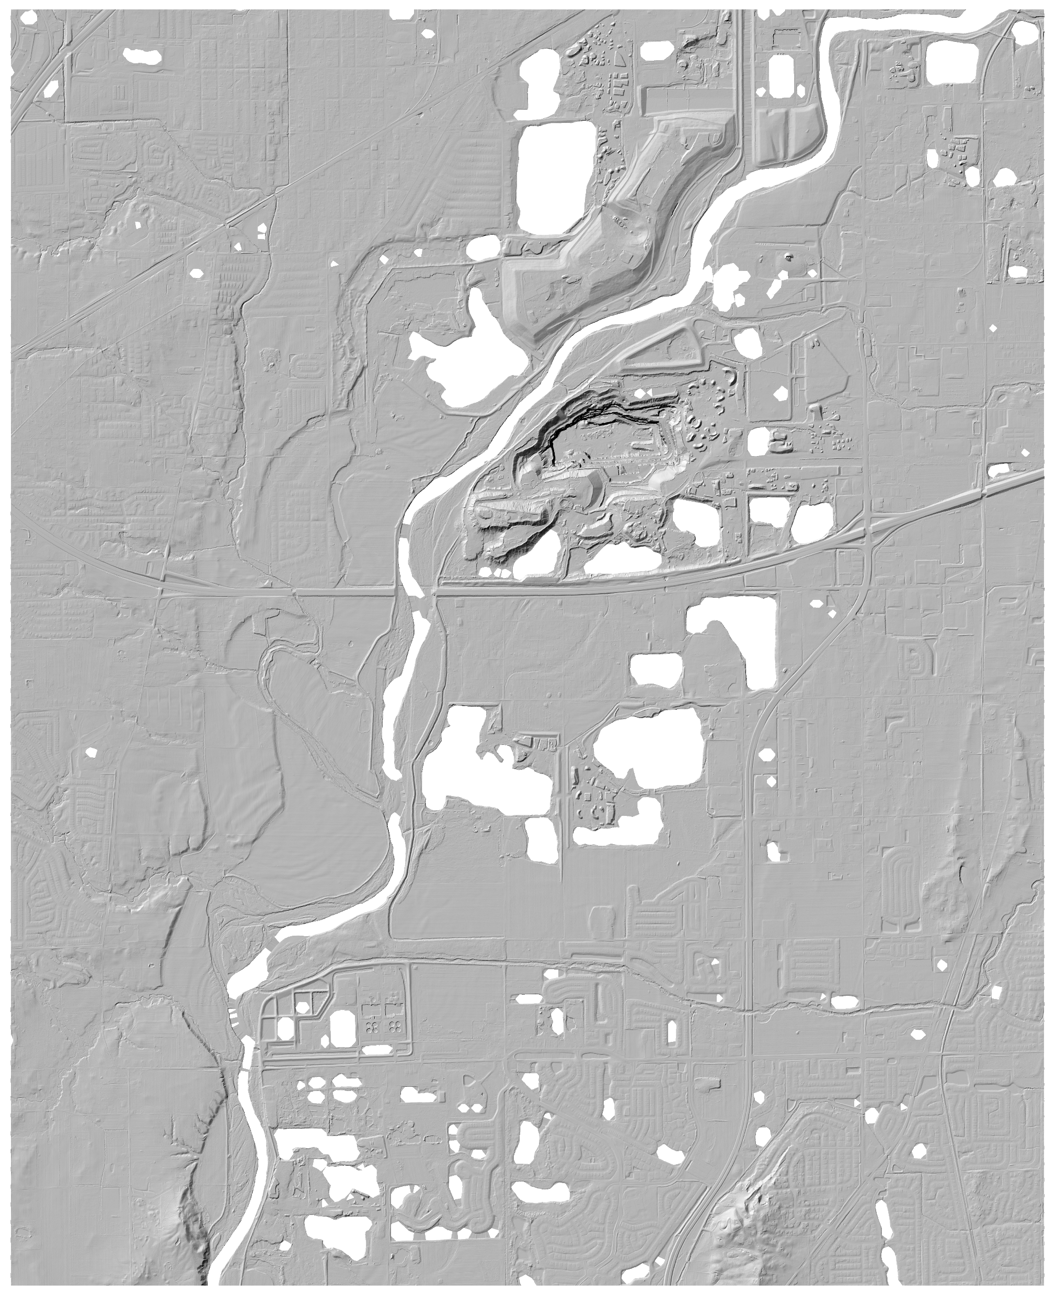
Lidar Hillshade, Full Surface
Lidar Hillshade, Bare Earth
Notes:
Notes: Lidar hillshade images of Indianapolis, Indiana. Left, a digital surface model (DSM), this represents all the uppermost surfaces on a landscape including buildings and vegetation. Right, a digital terrain model (DTM), this depicts just the bare earth surface.

Slide 9
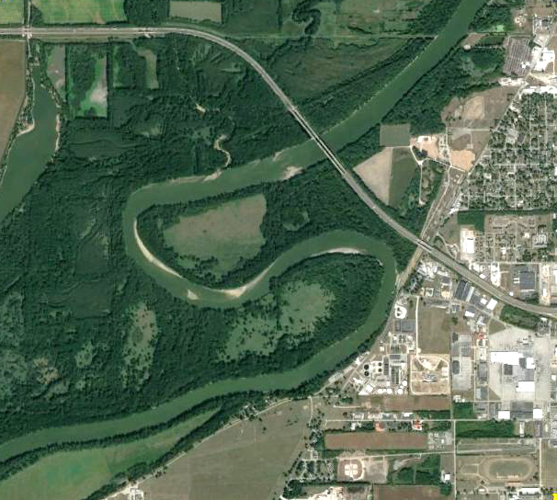
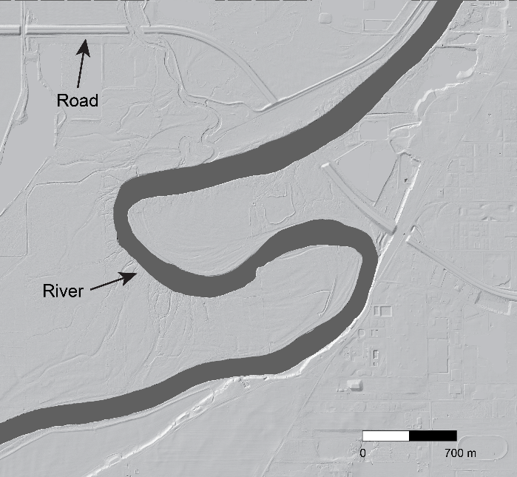
Satellite Imagery
Lidar Hillshade (Bare Earth)
Notes:
Notes: Comparison of Google Earth satellite imager (left) with a lidar bare Earth hillshade (right). Have students discuss the similarities and differences between the two images. Which image is it easier to see the details of the river in?

Slide 10
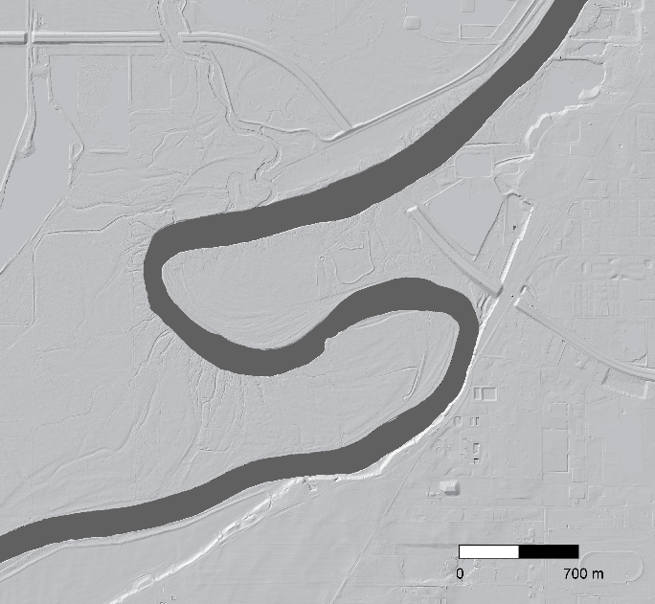
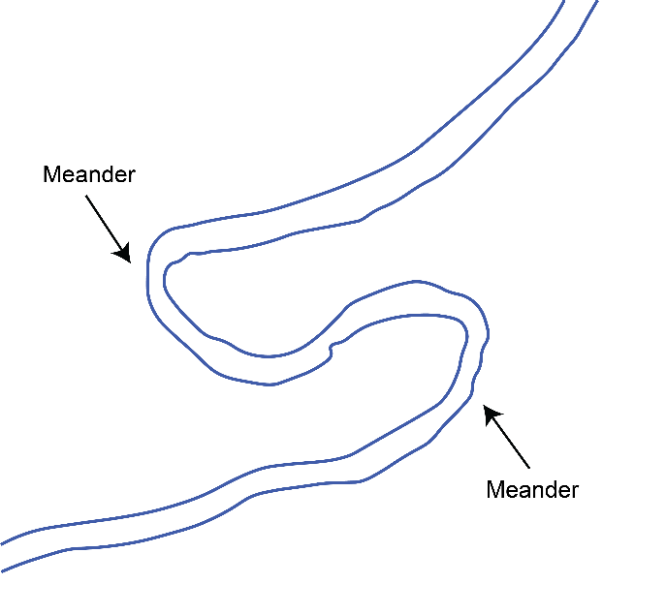
Lidar Hillshade
Mapped River Channel
Notes:
Notes: How to map a river channel from a lidar hillshade. The river is shown in dark gray in the left image. To map the river, outline along each bank of the river.

Slide 11
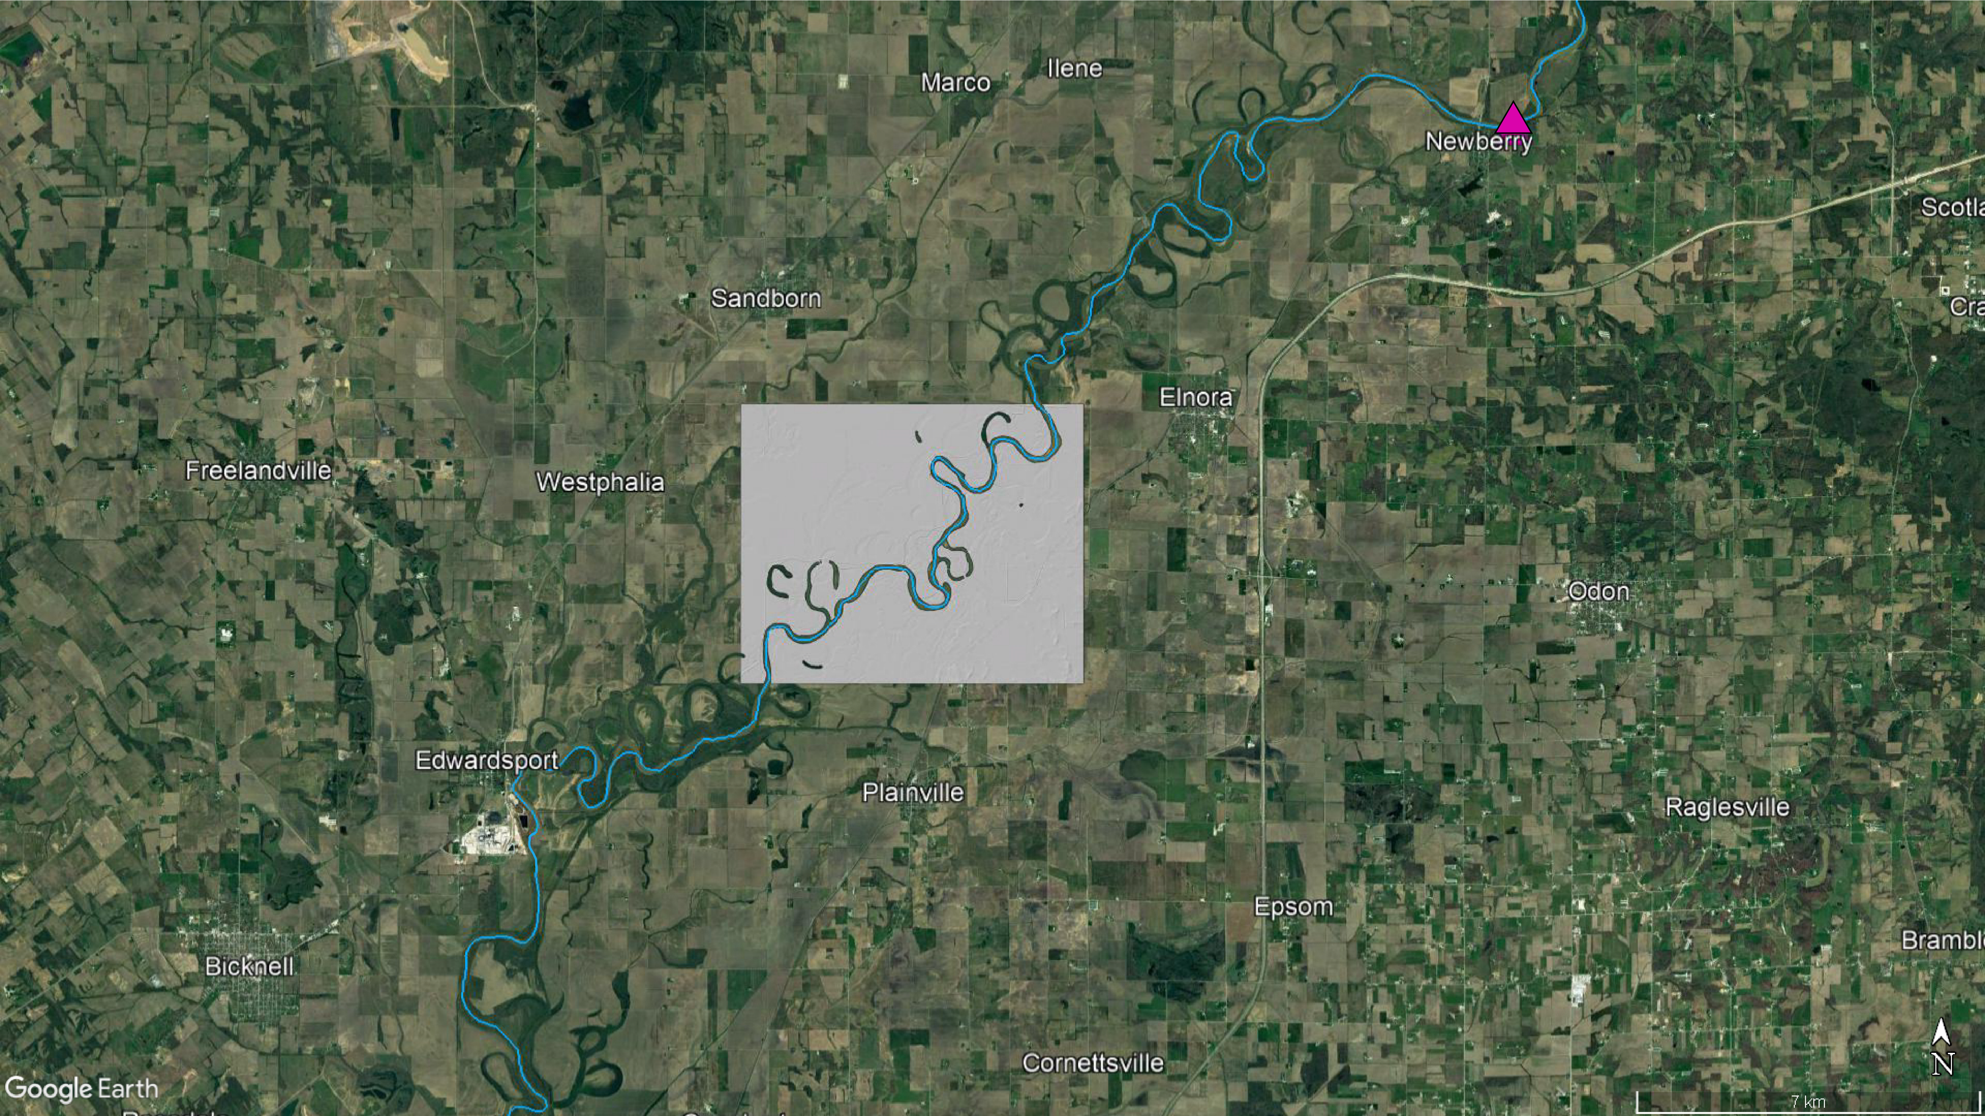

INDIANA
White River
Notes:
Notes: Location of portion of the White River in Indiana in this exercise using imagery from Google Earth. The gray box indicated the portion of the river that will be mapped. The stream gage station where the discharge information is collected is shown with a pink triangle (Newberry, IN).

Slide 12
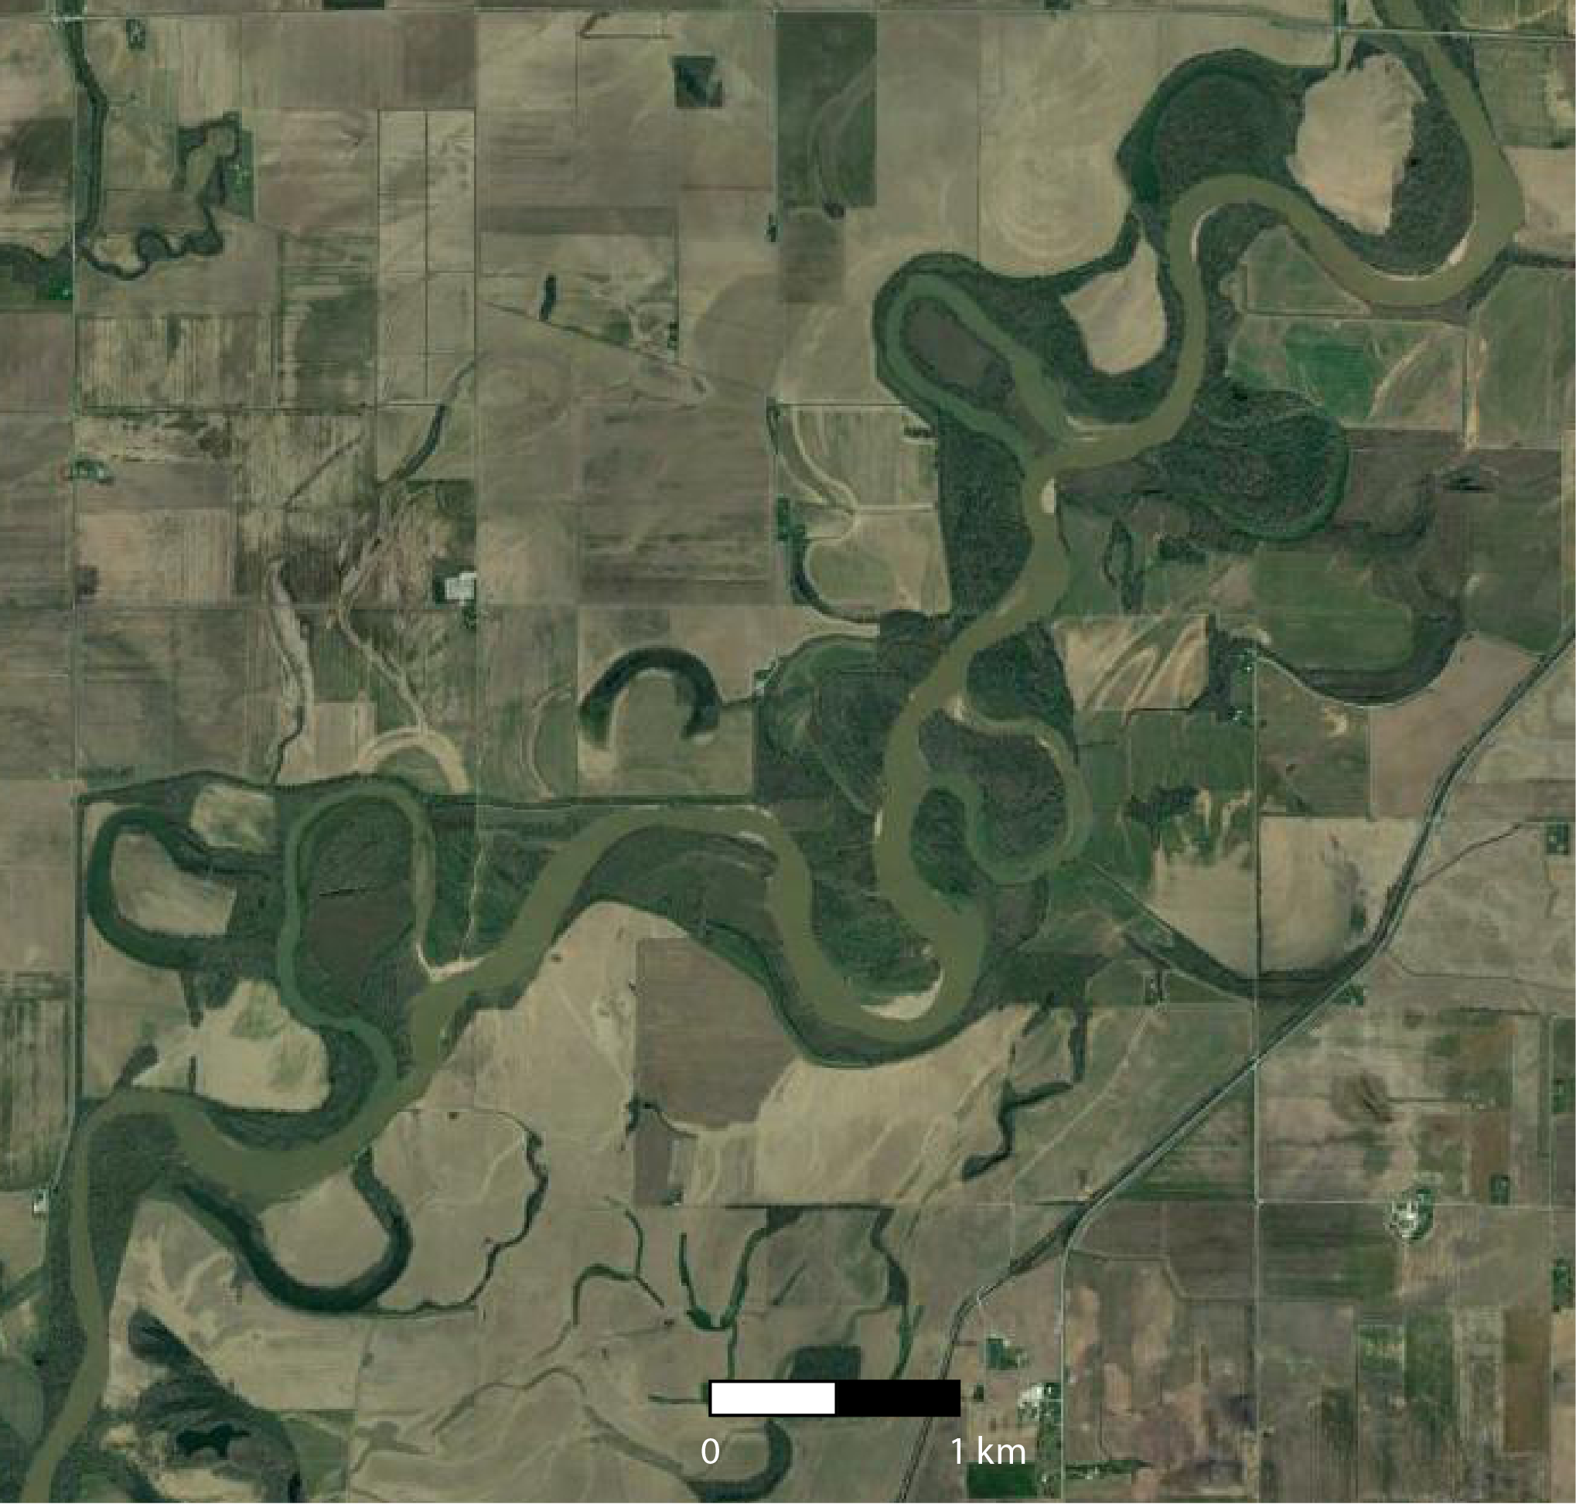
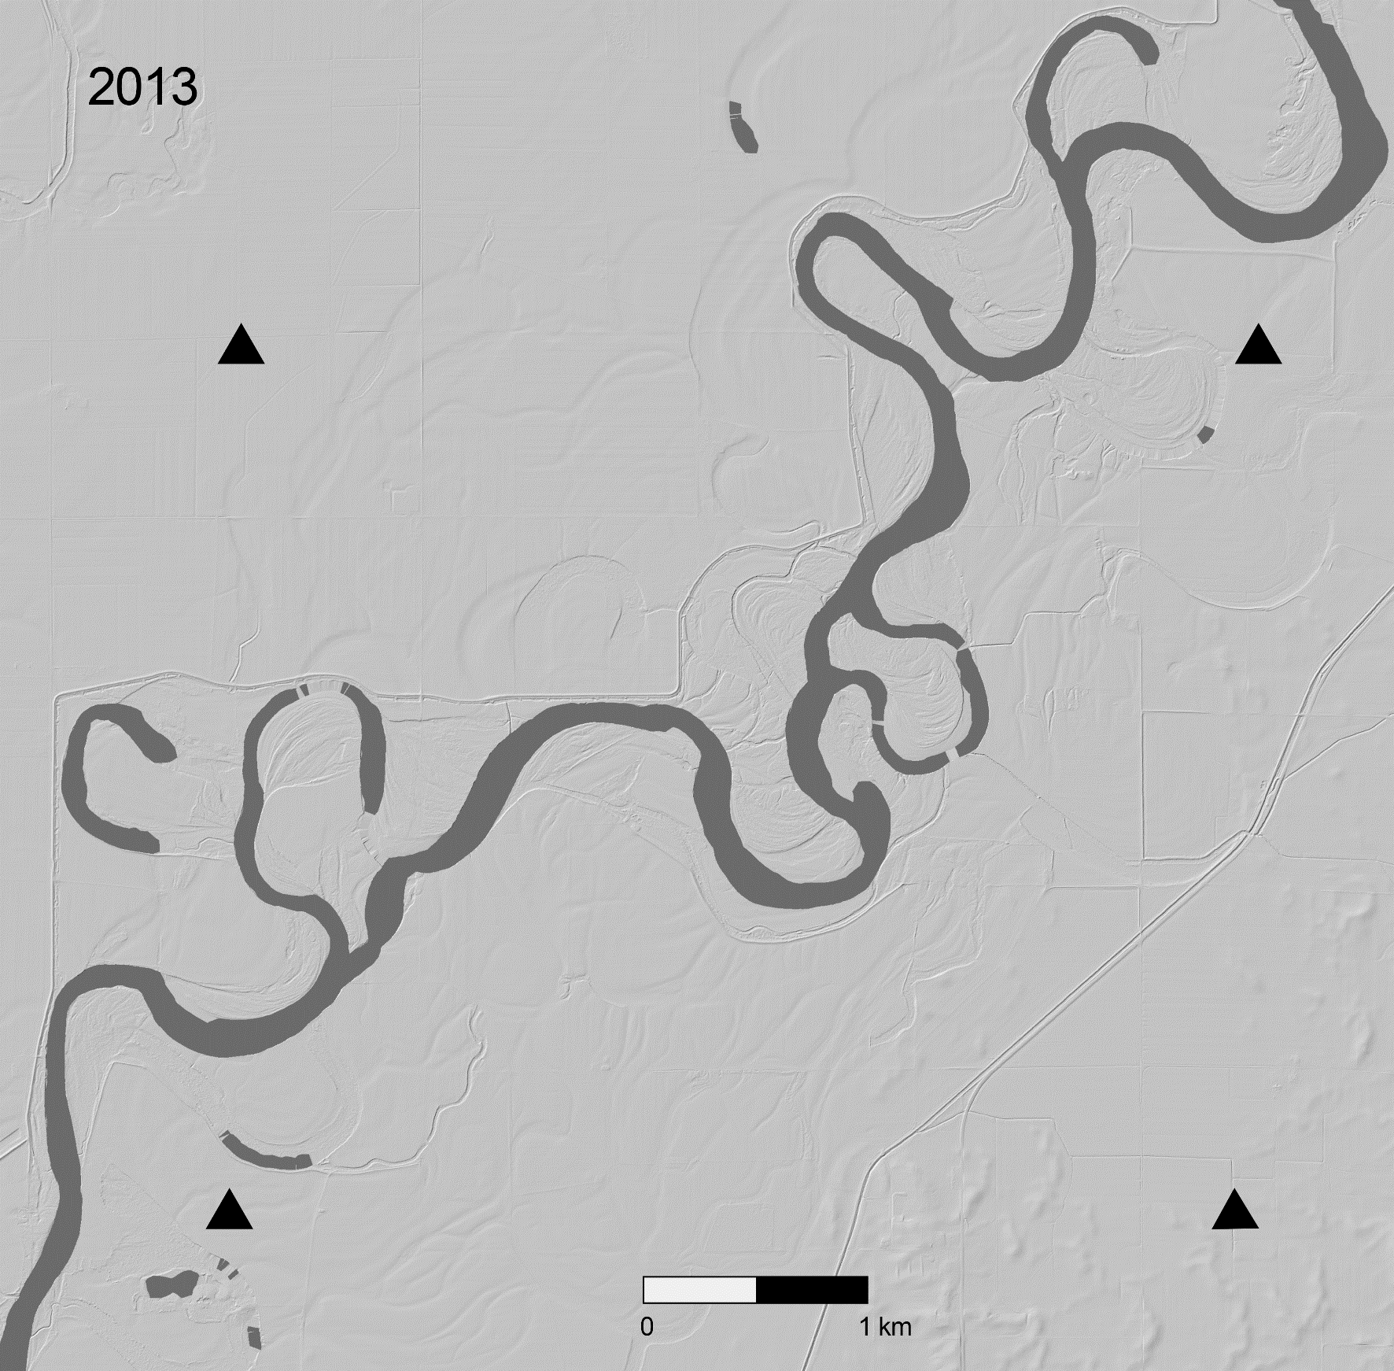
Satellite Imagery
Lidar Hillshade
2016
Notes:
Notes: Google Earth satellite image of the White River (left) and lidar hillshade image used in this exercise (right). The imagery accessed from Google Earth was acquired March 28, 2016.

Slide 13
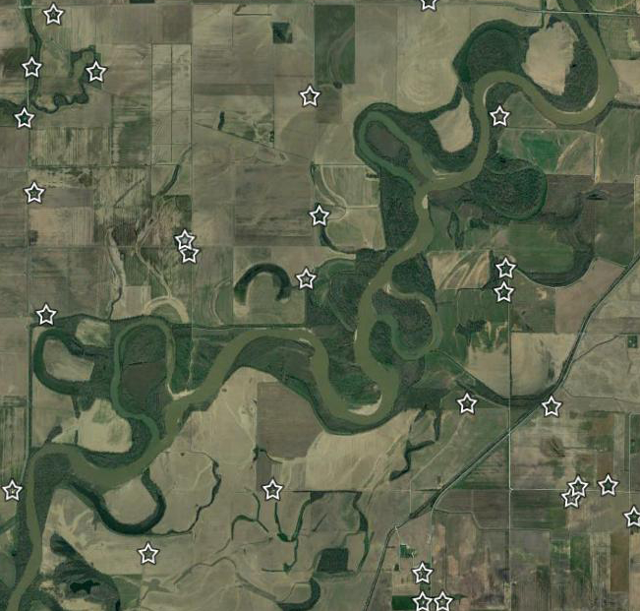
Satellite Imagery (stars=buildings and structures)
Lidar Hillshade
Notes:
Notes: Google Earth satellite image of the White River with locations of buildings and structures marked with stars (left) and lidar hillshade image used in this exercise (right). The imagery accessed from Google Earth was acquired March 28, 2016.

Slide 14
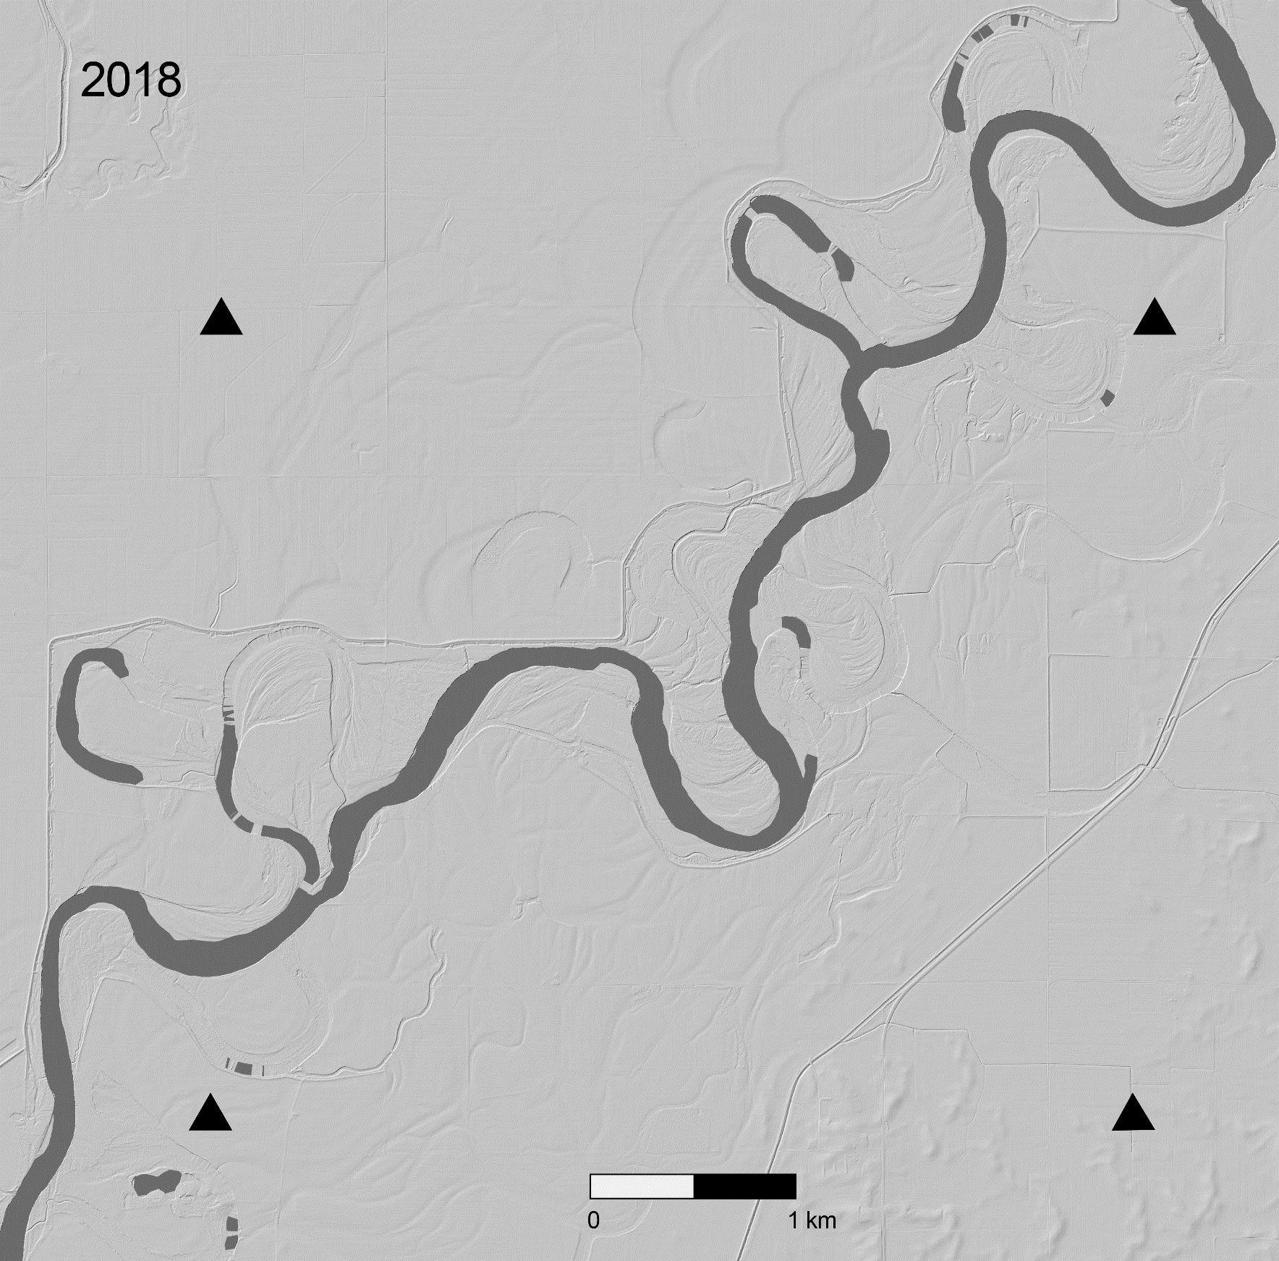
Notes:
Notes: Lidar hillshade images from 2013 and 2018 of the White River used in mapping exercise.

Slide 15
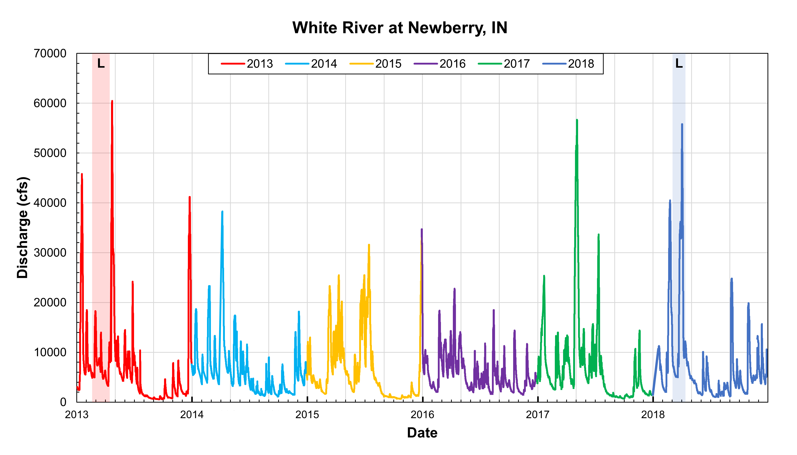
Notes:
Notes: Discharge in cubic feet per second (cfs) of the White River, Indiana from 2013 through 2018 from the USGS gage station at Newberry, Indiana. “L” indicates the lidar collection period. It is unknown what specific day from this period the lidar over this section of the White River was collected.

