Slide 1
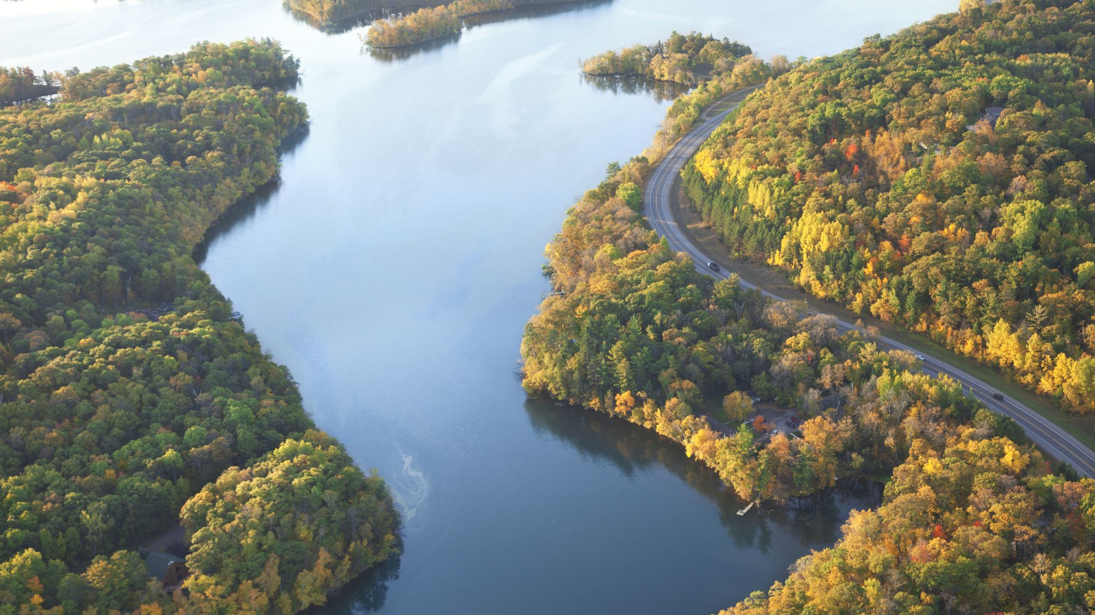

Using lidar to track Lake Michigan bluff retreat and inform local communities
LABORATORY

Slide 2
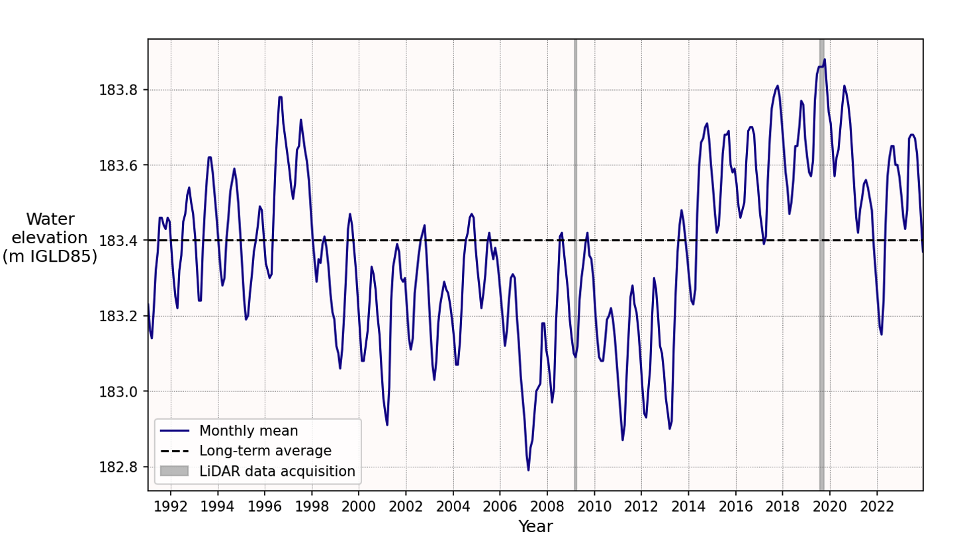
What causes coastal erosion at the Great Lakes?
Water levels at the Great Lakes depend on climate (precipitation, ice cover)
Warmer temperatures and loss of winter ice cover can lead to greater fluctuations in water levels and more intense storms
Lake Superior water levels

Slide 3
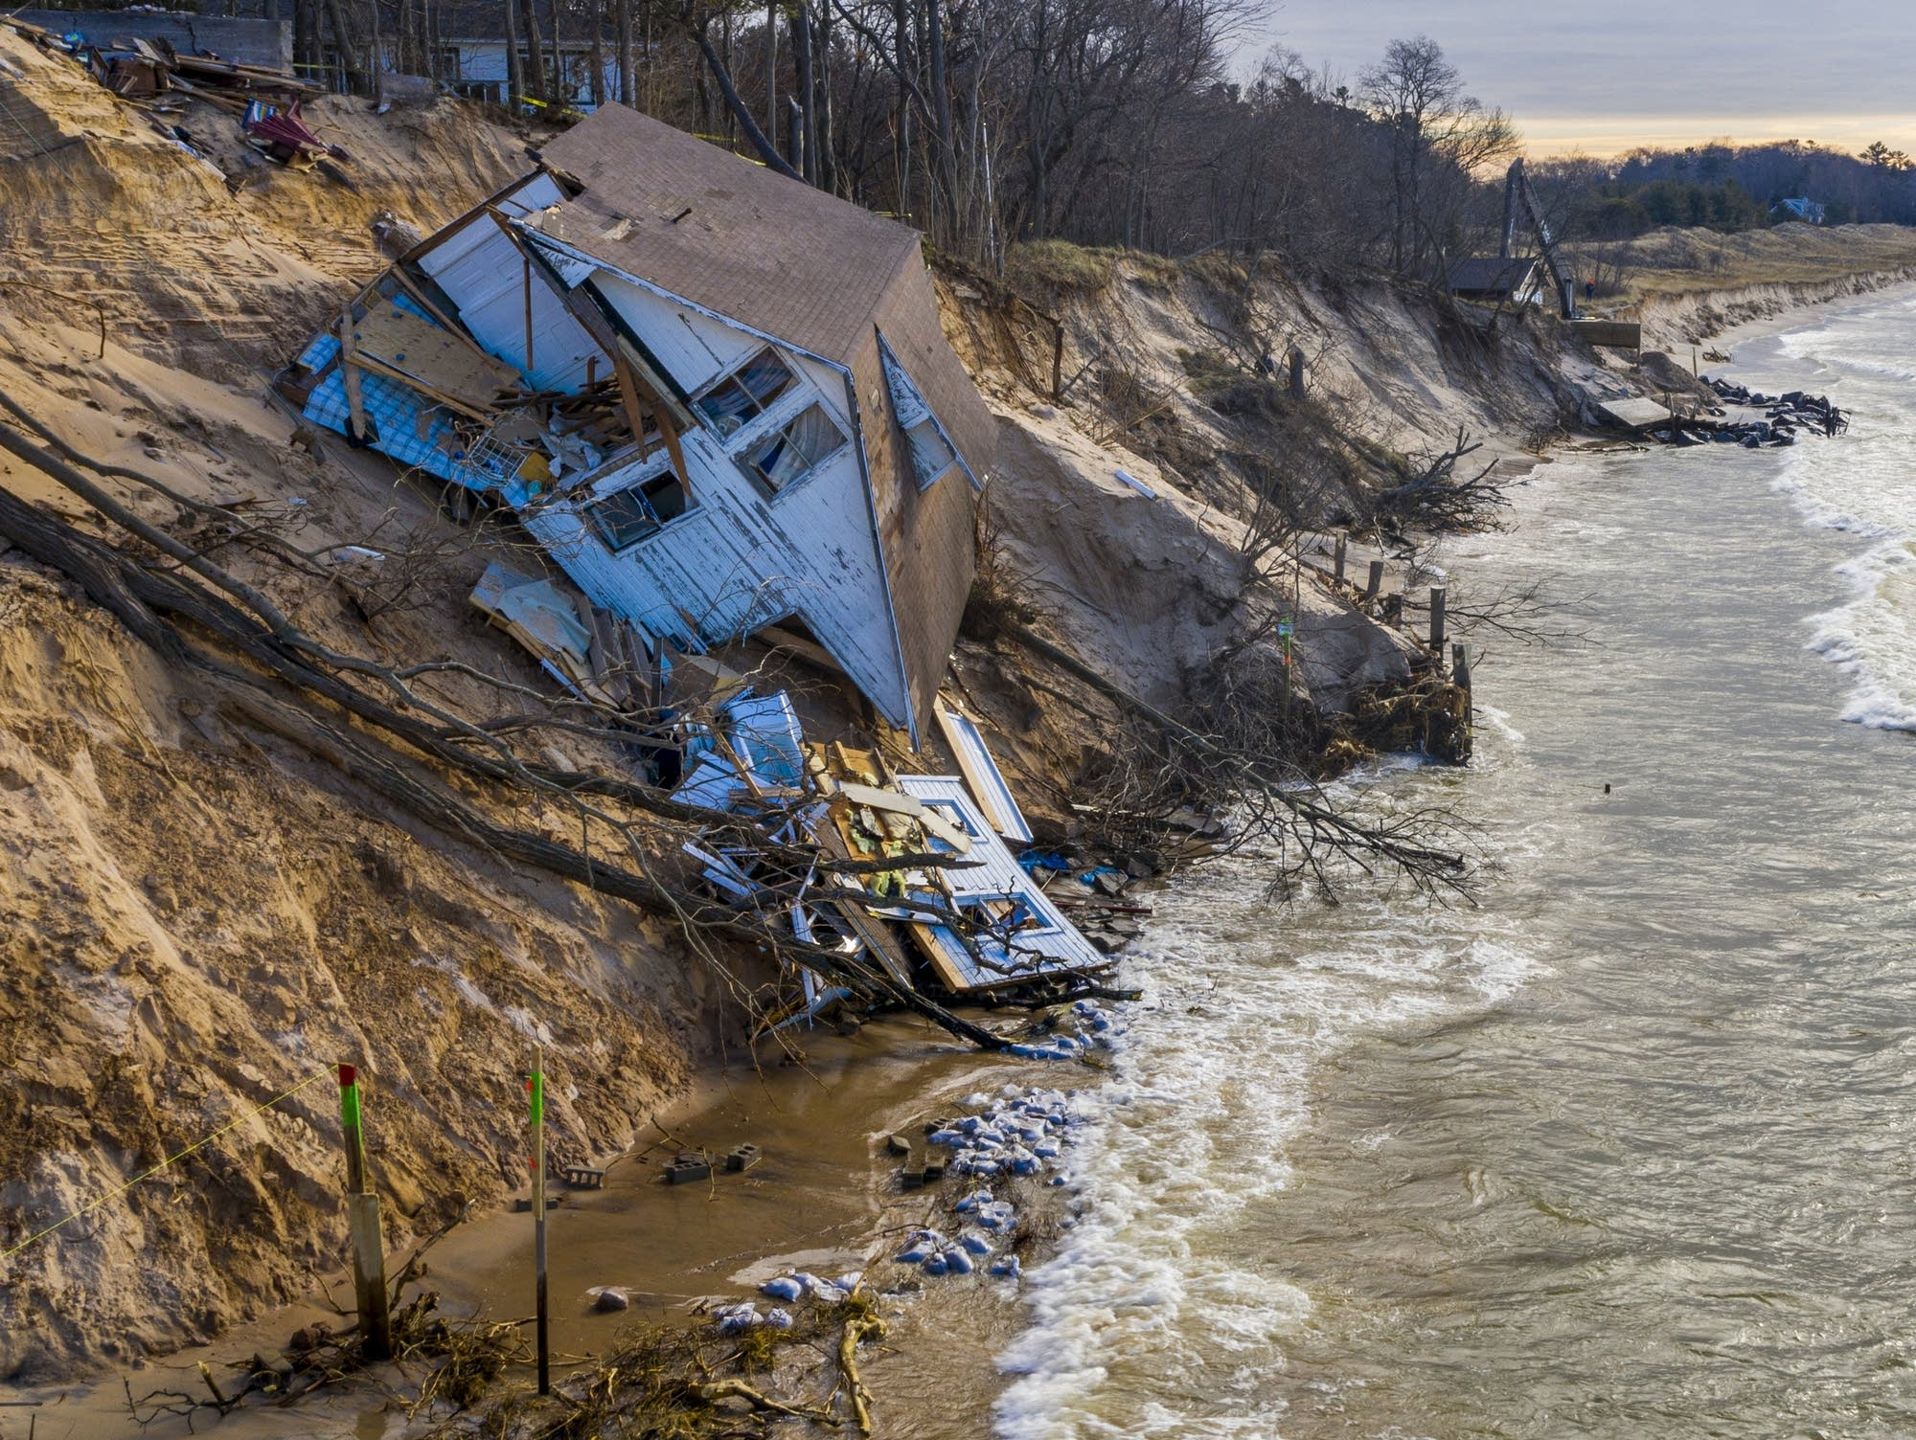
Why does coastal erosion matter?
When lake levels are high, waves erode the base of bluffs
Homes and infrastructure built along coastlines are vulnerable to slope failure, storm damage, and loss of beaches
https://www.mprnews.org/story/2020/01/04/erosion-claims-home-along-lake-michigan-bluff

Slide 4
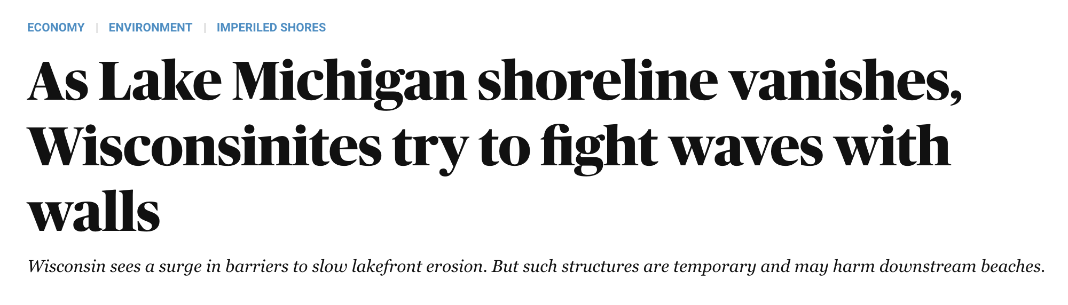
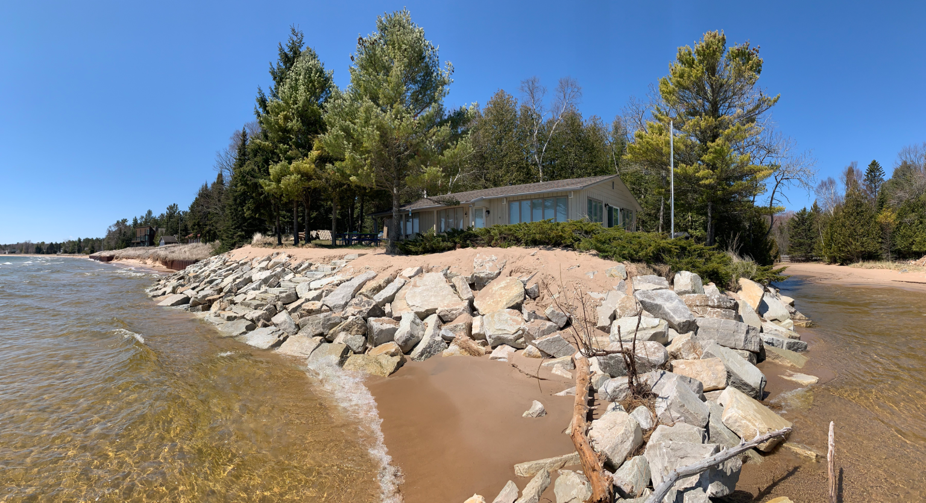
What are the costs of coastal erosion?
Costs include: property damage, loss of beaches, economic losses that affect tourism and local communities
Wisconsin cities will spend at least $245 million over the next 5 years to protect coastlines
https://wisconsinwatch.org/2021/11/as-lake-michigan-shoreline-vanishes-wisconsinites-fight-waves-with-walls/

Slide 5
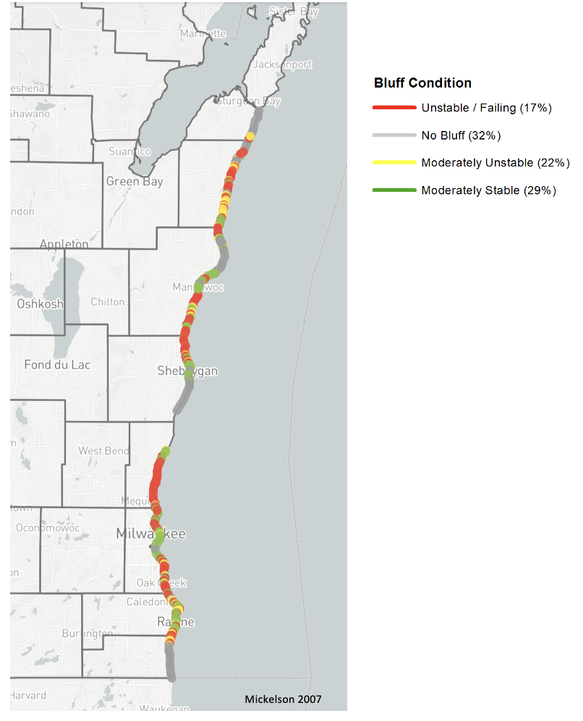
How do we track changes to coastal bluffs?
2018-2019 Shoreline Inventory
Lidar (remote-sensing) measurements of coastal bluffs, and monitoring water lake levels

Slide 6
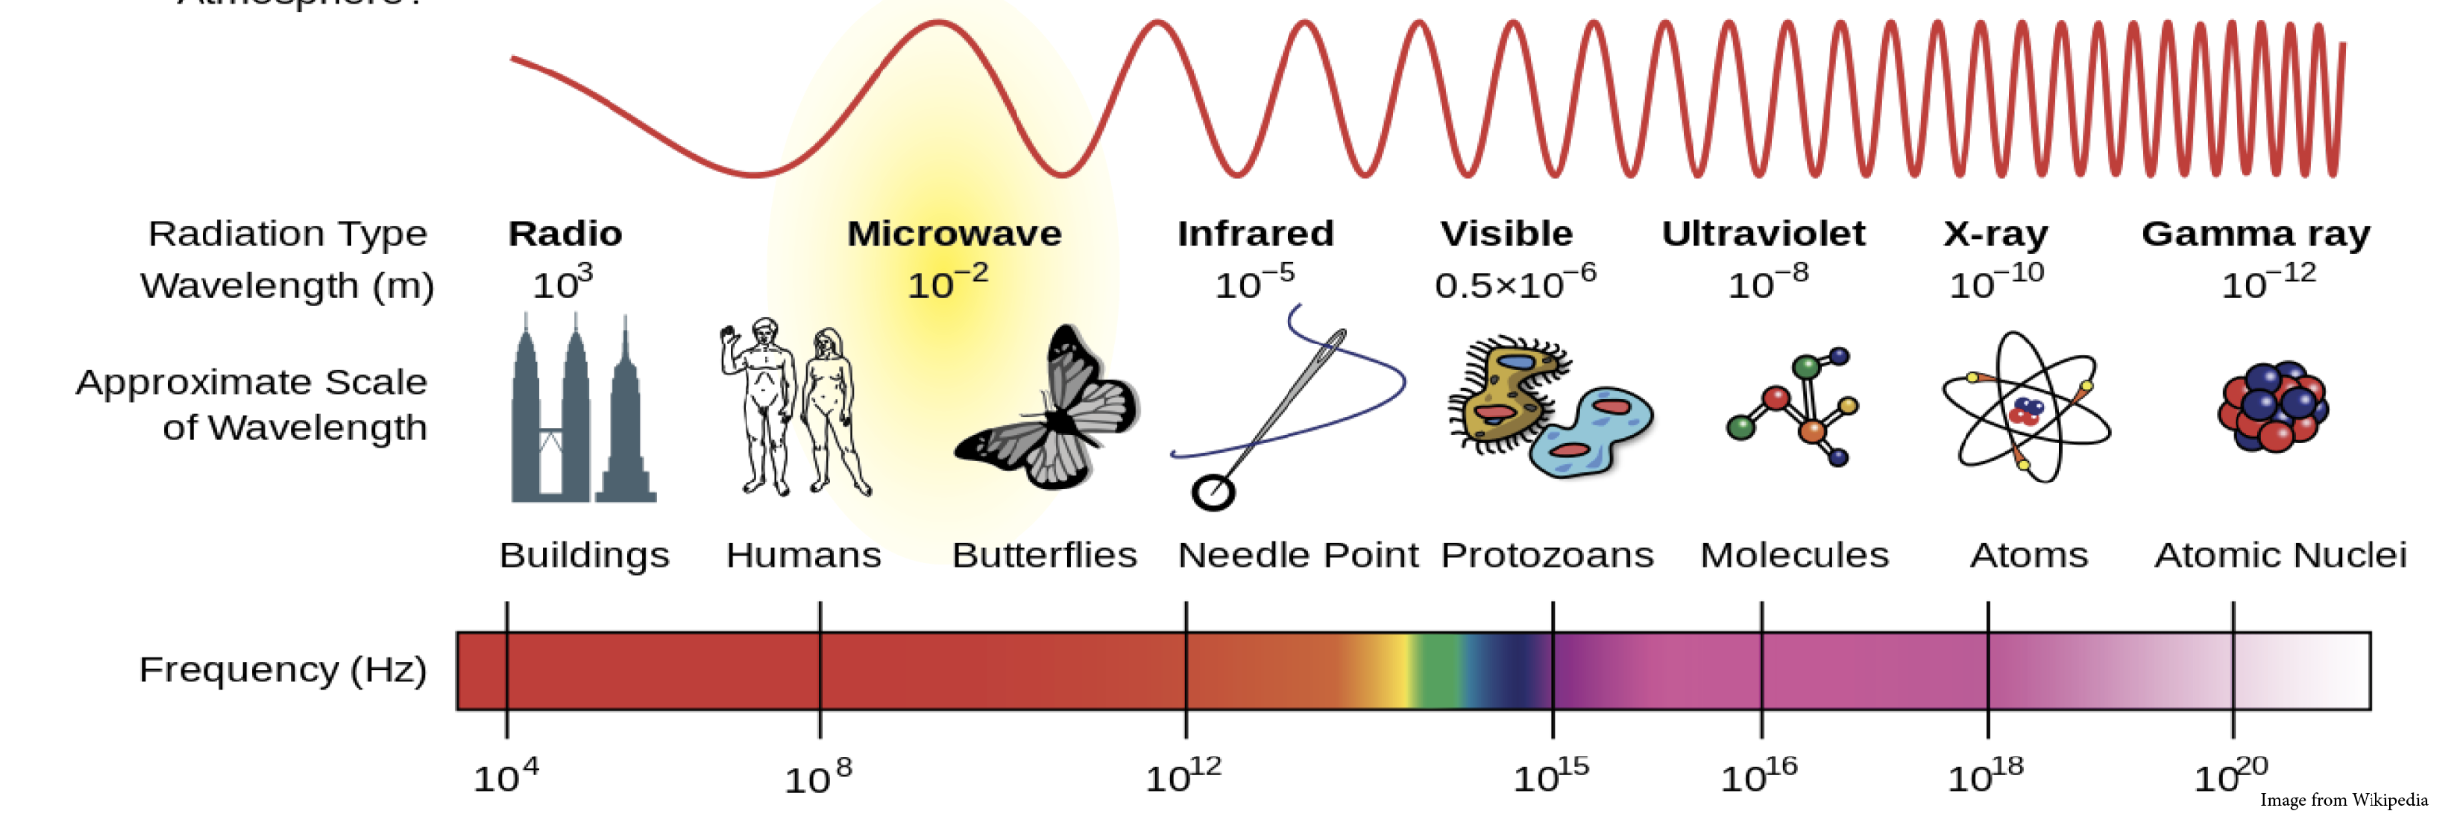
What is Lidar?
Lidar:
Mostly near infrared, commonly 1064nm
Topo-bathymetry uses a green wavelength, 532 nm
Notes:
This shows the electromagnetic spectrum showing wavelength and and frequency. Long wavelength are radiowaves with 10^3 m wavelength and short wavelenfths are gamma rays with 10^-12 m.
Most lidar has a near infrared wavelength (1064 nm).
Typo-bathymetry uses green light (532 nm). These penetrates shallow water (like coastal environments) better than other wavelengths.

Slide 7
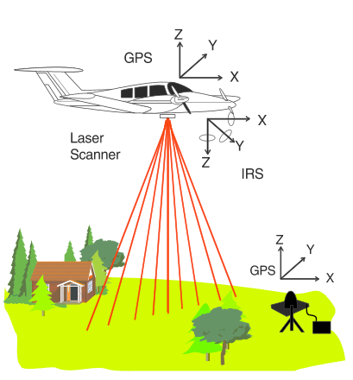
How do we collect lidar data?
Three main components to provide a georeferenced elevation measurement:
Laser & Sensor
Inertial Measurement Unit (IMU). Records roll, pitch, yaw of platform.
GPS
Notes:
Lidar data is often collected with an aircraft, called airborne lidar
Laser: Emits the signal
Sensor: Records the return signal
Inertial Measurement Unit (IMU): Recording very precicely where the laser is pointing,
GPS: Location of aircraft
High quality IMU and GPS are critical for measuring position

Slide 8
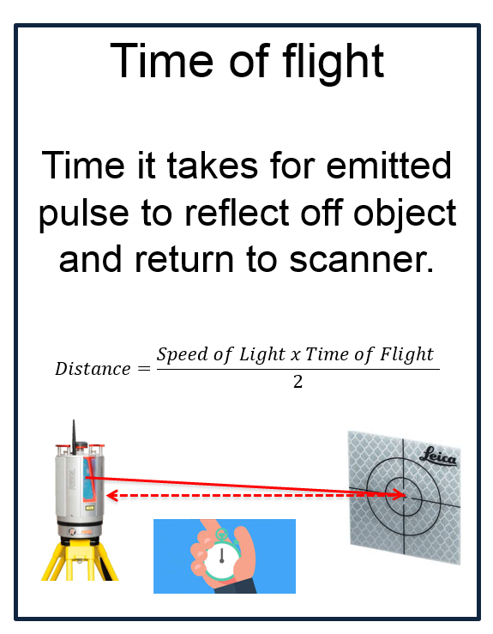

How does lidar work?
LIght Detection And Ranging
Distance is calculated by measuring the two-way travel time of a laser pulse.
Need very accurate clocks
Notes:
In lidar, the system measures that time for an emitted pulse to reflect off an object and return to the sensor.
This time indicates the distance between the sensor and the ground. With the knowledge of the aircraft location, we can compute the elevation of the ground.

Slide 9
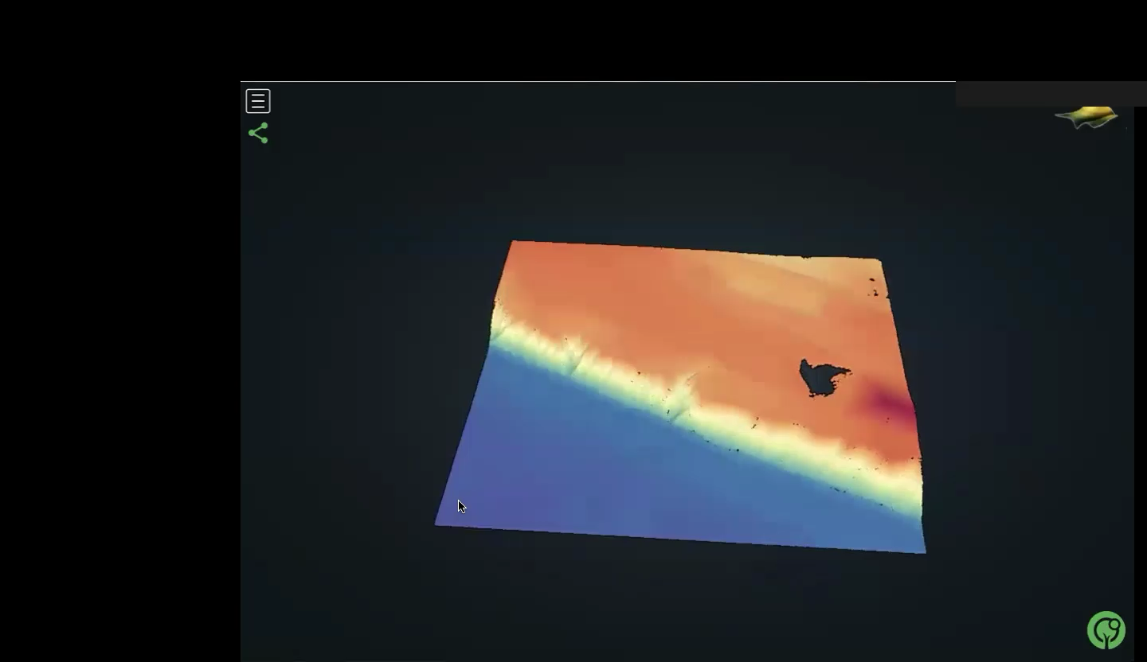
Notes:
This video shows a lidar topographic point cloud of coastal bluffs in Wisconsin colored by elevation.
Blue: low elevation, water
Yellow: medium elevation along the bluffs
Orange to red: high elevation
Shows zooms to retreating bluffs

Slide 10
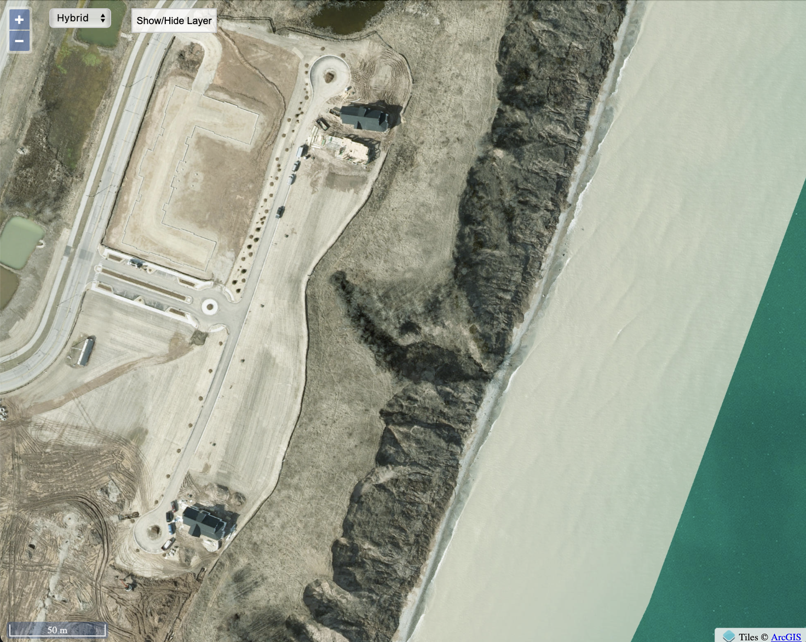
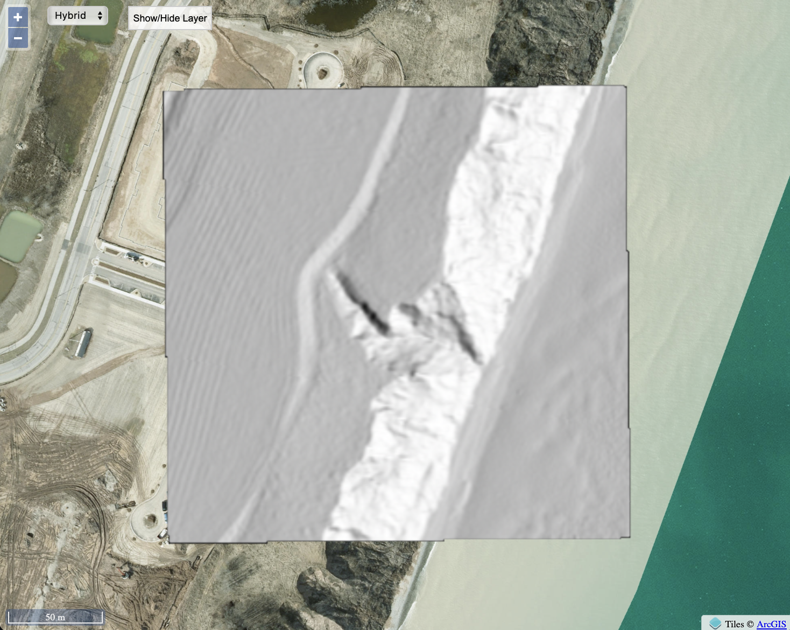
Imagery (left), topographic hillshade (right)
Along Wisconsin coastline. Hillshade: Shows the landscape and relief as being lit from the sun from certain direction (here ESE): Steep cliffs are white, flatter part are gray. Can see detail in coastal bluffs and in landscaping. Imagery from 2023, lidar data is from 2020, so roads are different.
Notes:
Along Wisconsin coastline. Hillshade: Shows the landscape and relief as being lit from the sun from certain direction (here ESE): Steep cliffs are white, flatter part are gray. Can see detail in coastal bluffs and in landscaping. Imagery from 2023, lidar data is from 2020, so roads are different.

Slide 11
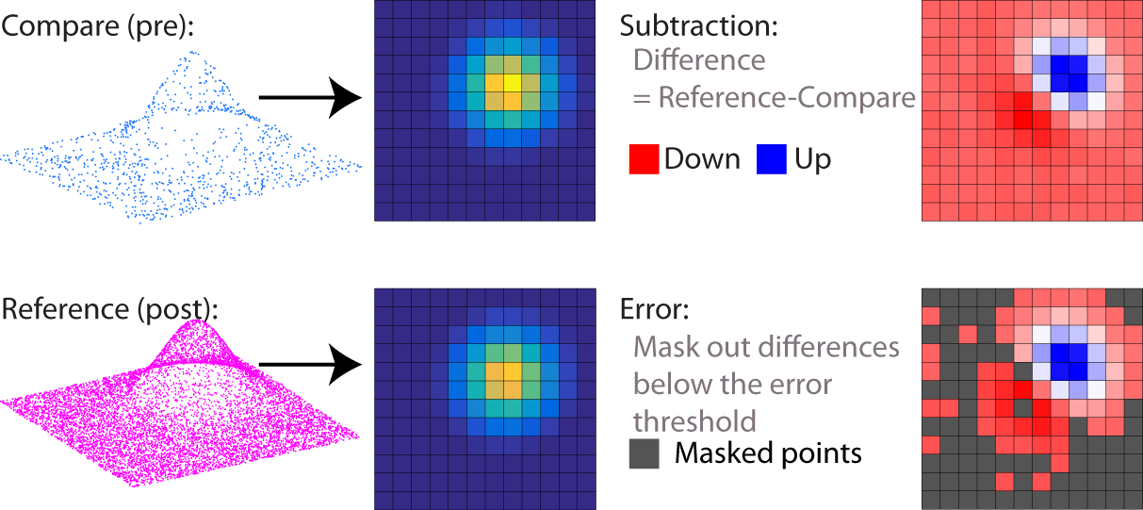
How do we measure change using lidar? –
Vertical Topographic Differencing
Identical grid for pre and post event topography
Notes:
Vertical topographic differencing: This process begins with two point clouds, one before a geological event here shown in blue and one after the event here shown in pink. Often times, the earlier dataset again here the one in blue as a lower resolution of fewer points compared to the later dataset. Both point cloud datasets are gridded to raster grids with the same resolution and bounding box.

Slide 12
Vertical Topographic Differencing
Raster subtraction
Notes:
The pre and post earthquake rasters are subtracted resulting in the differencing map shown on the right. The red indicates downward motion of the ground surface from processes like erosion or the removal of vegetation or buildings. Blue indicates upward motion, for example from deposition or the construction of a new building.

Slide 13
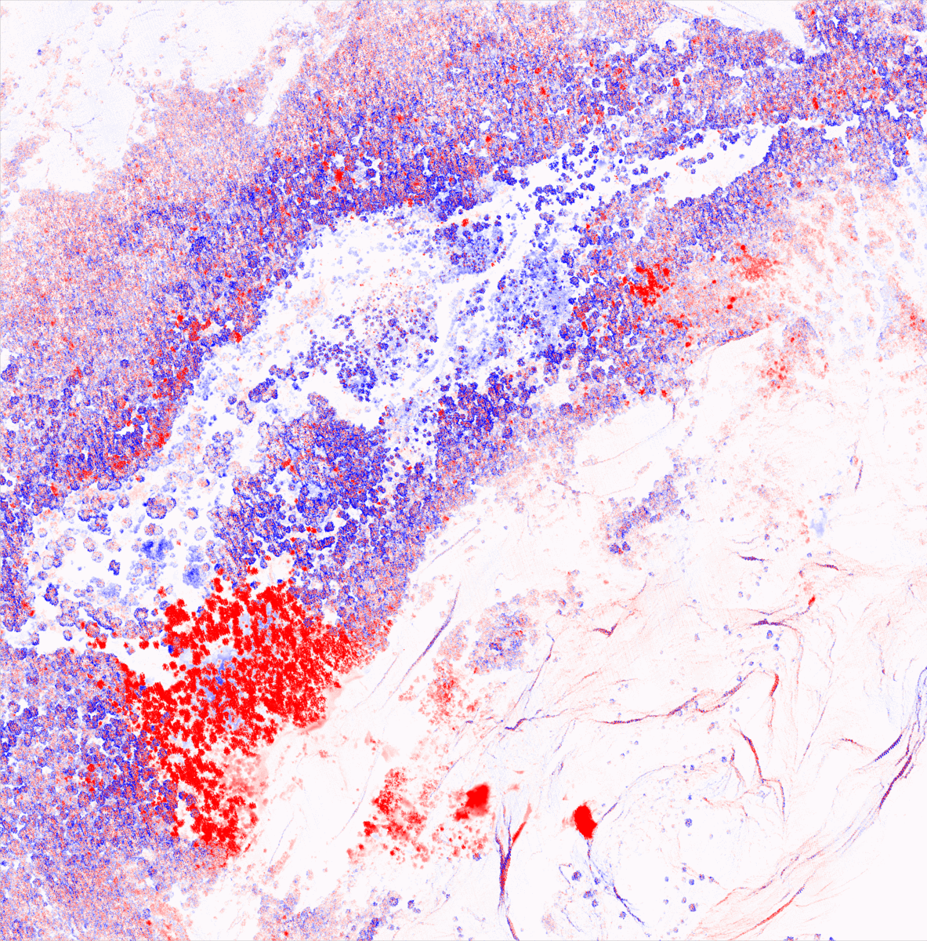
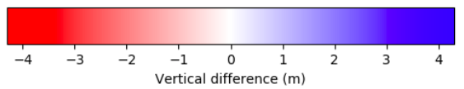
Yosemite, California
2006-2010
- 15 m
0 m
15 m
Notes:
This is Yosemite National Park in California.
Set of images; The two gray images are topographic hillshades, showing the before and after lidar. The third is the differencing map, where red indicates downward motion and blue indicates upward motion. This shows a major rockfall (lower left) and several smaller rockfalls. The rockfalls are all in red, showing the loss of material.

Slide 14
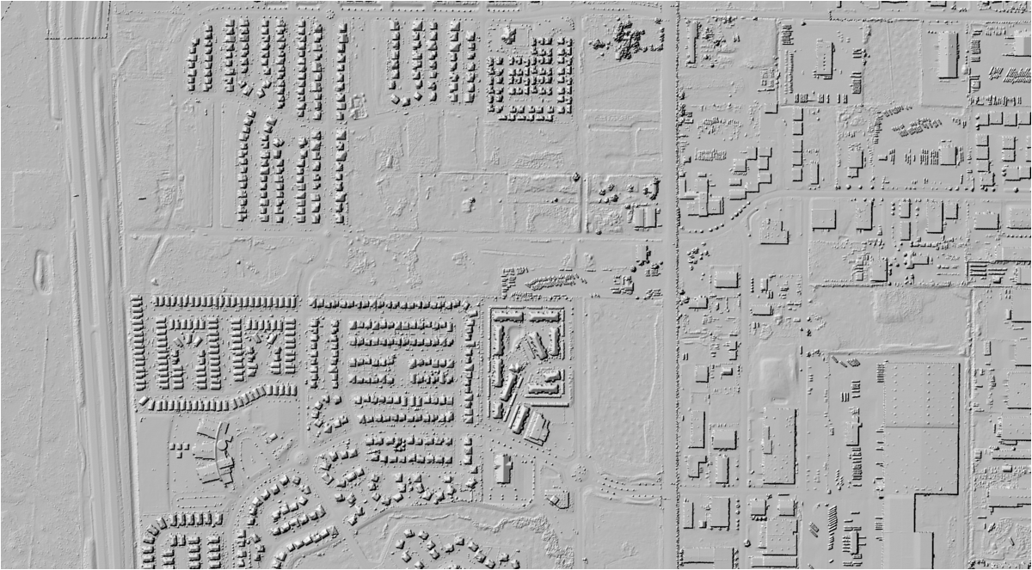
Salt Lake City, Utah
Vertical Difference (m)
-4
0
4
Notes:
This looks at topographic change in the built environment, in Salt Lake City. The grey topographic hillshades show a new development – the new squares are houses. The topographic change map shows positive change representing height increase from the buildings.

Slide 15
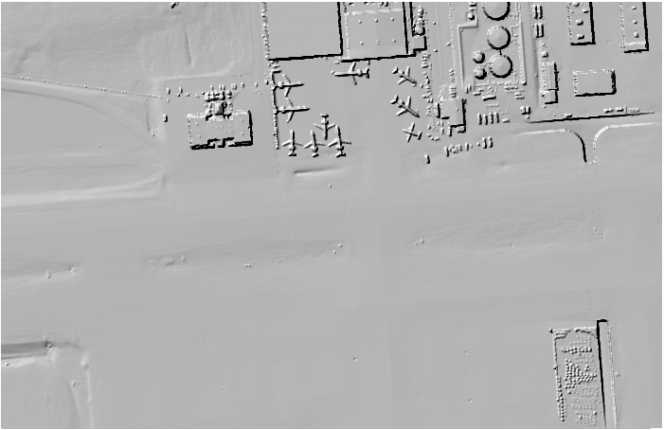
Salt Lake City Airport
- 15 m
0 m
15 m
Notes:
Salt Lake City, Utah, Airport: Topographic differencing reveals airplane location at the Salt Lake City Airport during the two lidar surveys. Red airplanes were present during the first lidar acquisition, and blue airplanes were present during the second acquisition. This is a tricky example, but good to think about.

Slide 16
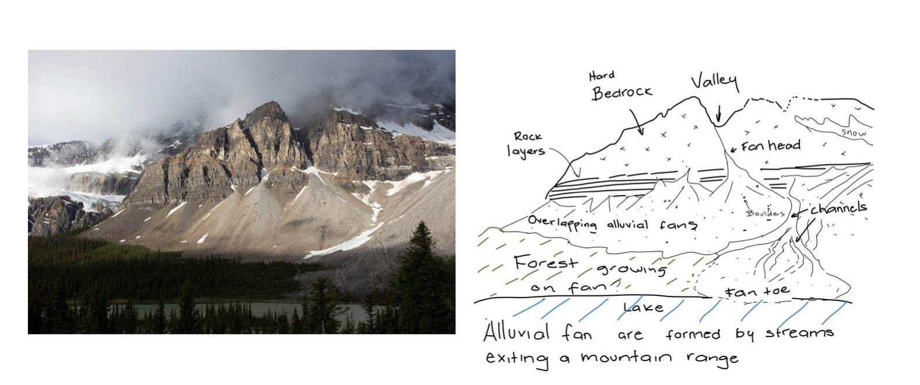
What is a sketch?
Contains labeled key features
Contains description of processes (annotations)
Has a title
Focus is on the content, not on the artwork

Slide 17
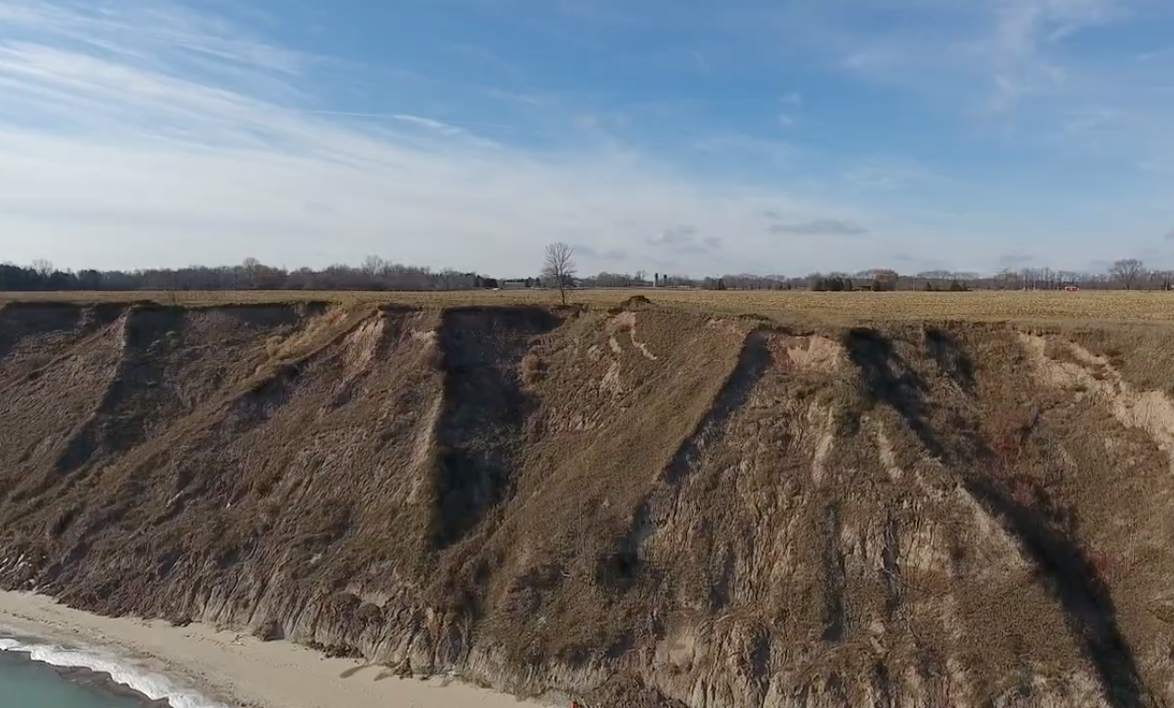
Resolving the lab–Sketching exercise
Your sketch should have labels, descriptions, and annotations.
As you draw, think about what may be going on in this view
Notes:
If time allows you can show this drone footage: Drone footage by Collin Roland and Luke Zoet (University of Wisconsin-Madison) https://youtu.be/b32nK4y-tEw

Slide 18
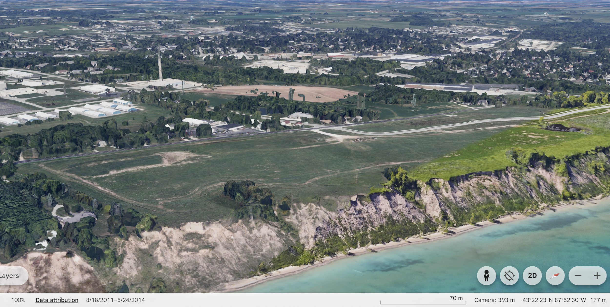
Visualizing satellite Imagery using Google Earth
Notes:
Show students how to use the controls in google earth and explain how you want them to label the image. For example, Shift, control, mouse to move around, going from 2D to 3D

Slide 19
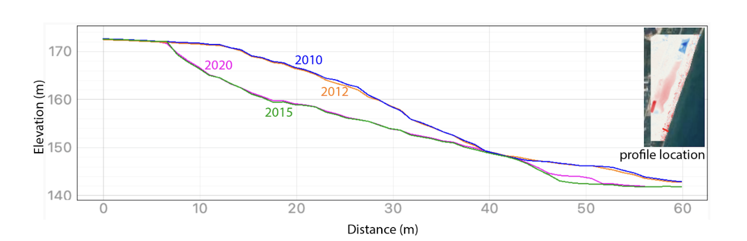
Interpreting the profile
Elevation along the coastal bluff (meters) vs distance perpendicular to the lake coastline measured with multiple acquisitions of lidar topography: 2010 (blue), 2012 (orange), 2015 (green), and 2020 (magenta).
Notes:
Instructor: make sure that the students know how to read the profile and that they are able to trace each profile from top left to bottom right with their finger. You may consider having students model the changes with playdough/clay/etc to physically make sense of the change. This is an excellent example of moving from 3D thinking to 2D translation (and back) that is a crucial skill in geoscience.

Slide 20
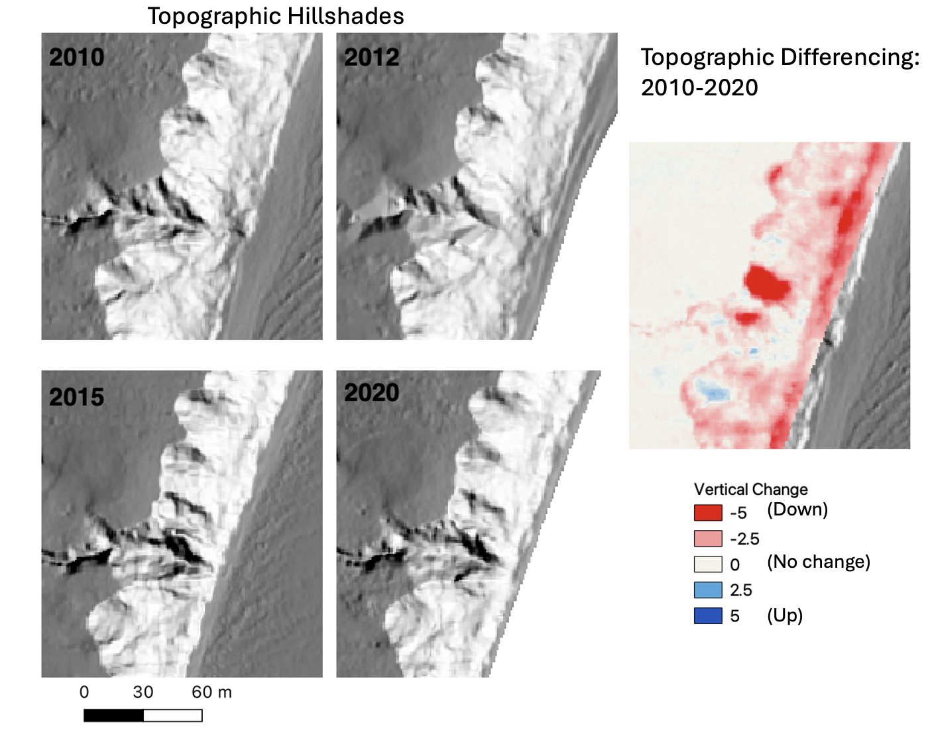
Using hillshades to study change over time
Notes:
Use this as an opportunity to make sure that students are interpreting the differencing correctly. Point out where the gully is on the hillsides and ask them to find it on the differencing panel. Make sure they understand where the crest recession is happening. Also, discuss where the most significant change is occurring in the image.

Slide 21
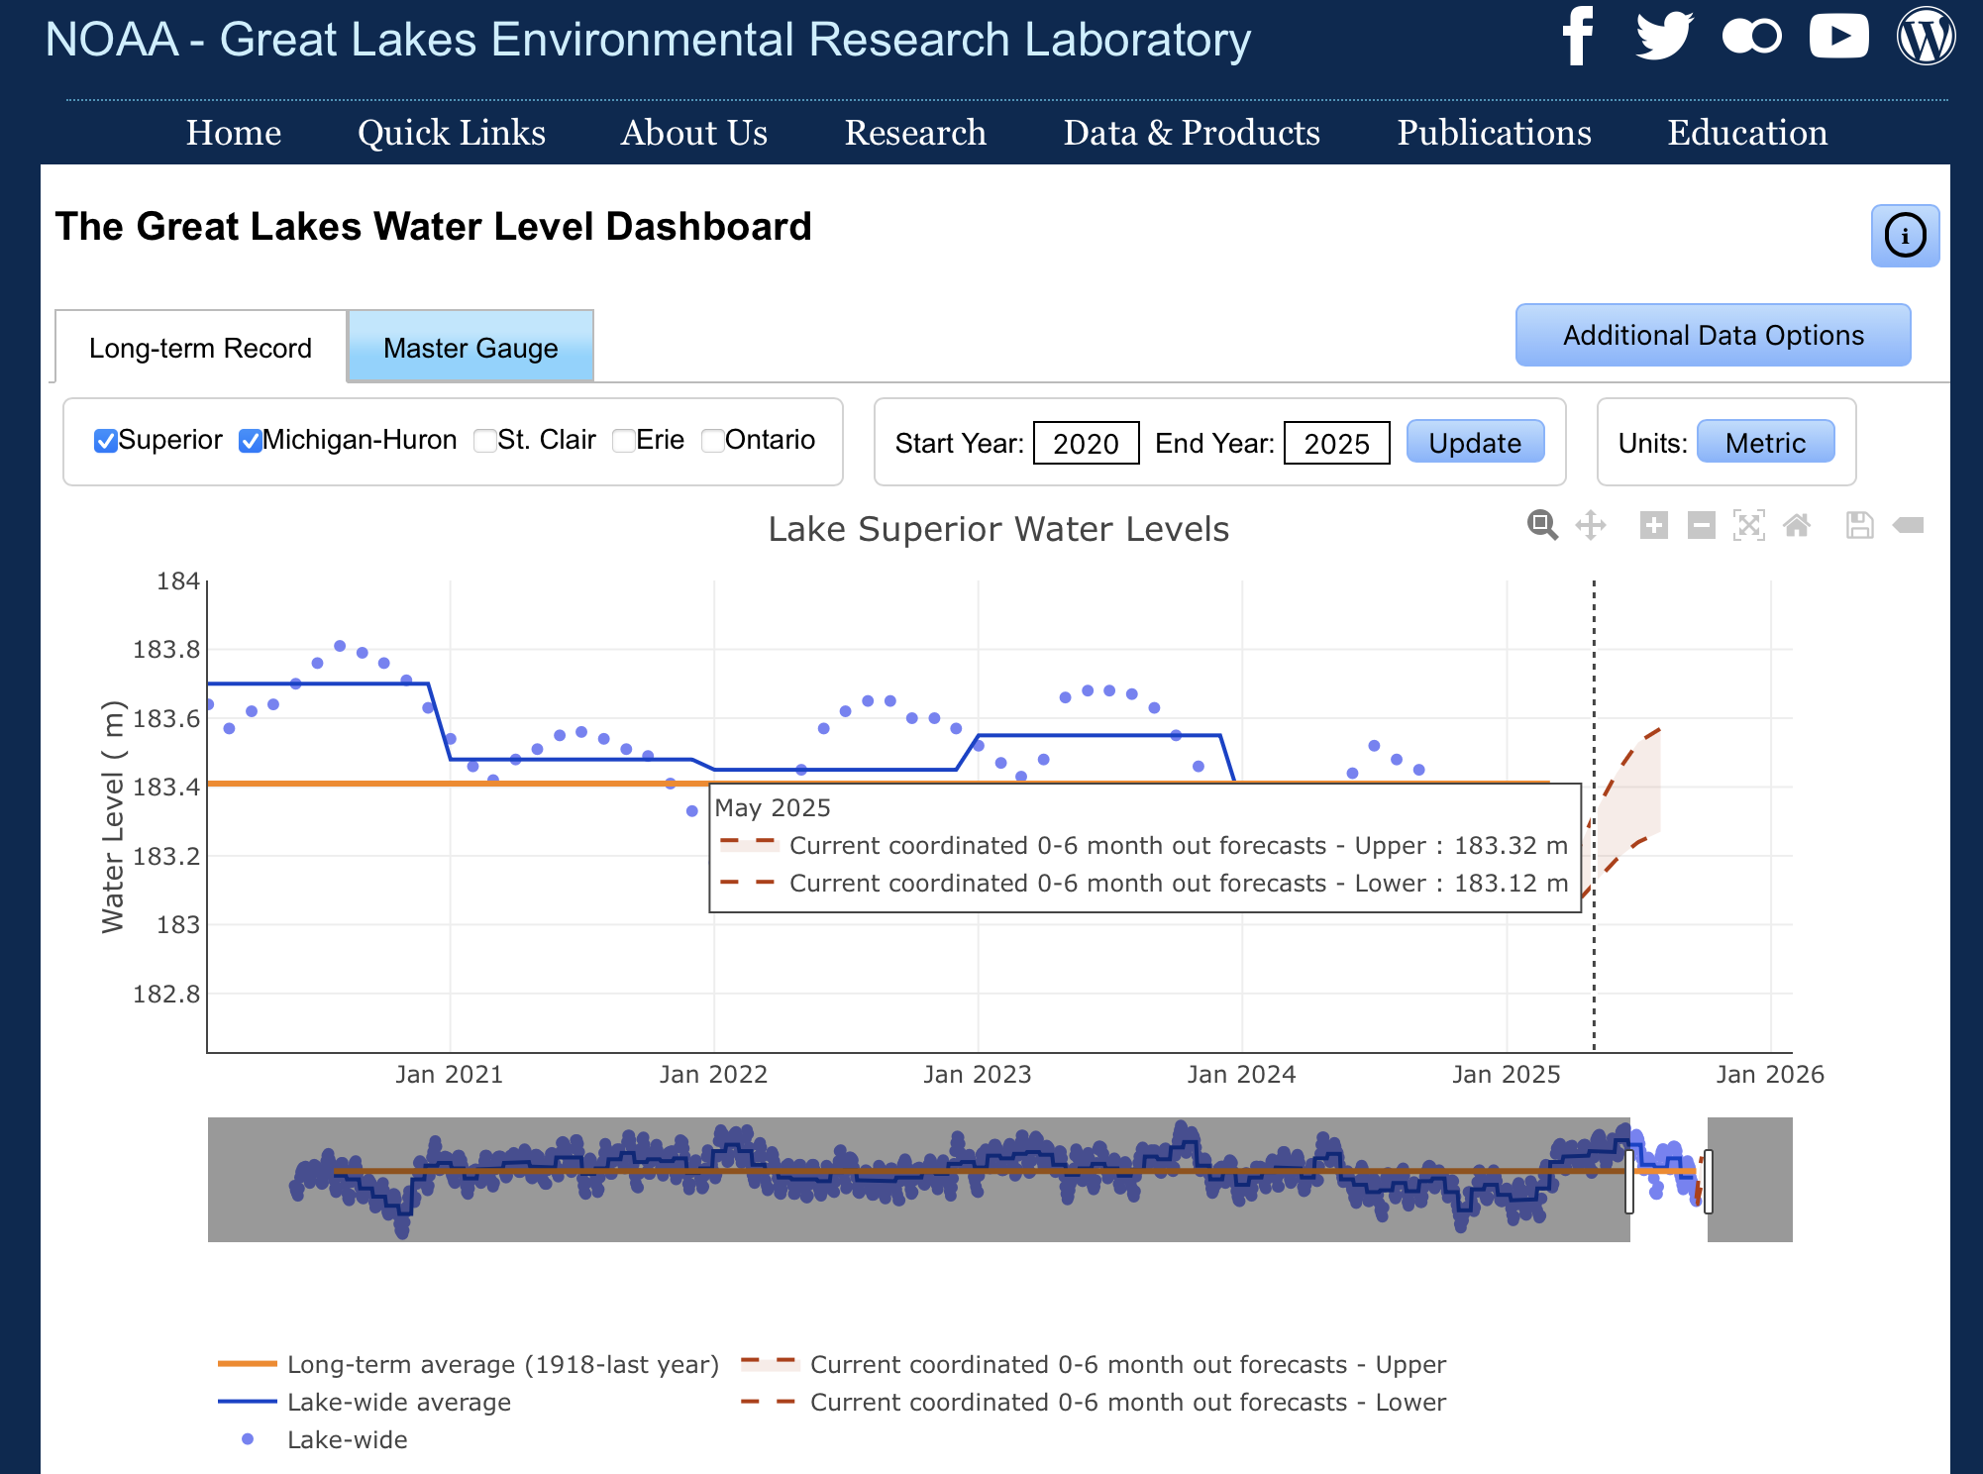
Accessing and using the Great Lakes Water level dashboard
Notes:
Make sure the link is active. You may not want to spend a lot of time here. Just show them how they can activate or deactivate the lakes. Also indicate which measurement (Lade-wide average) you would like them to report.

Slide 22

Applying scientific reasoning
Questions 12-17 are intended to help you reason scientifically. More than correct answers, you must clearly document your thought process.
Brainstorm with your classmates and ask your instructor if you need help

Slide 23
Questions?

Slide 24
To learn more…
Internet Geography. (n.d.). Field sketches in Geography. https://www.internetgeography.net/field-sketches-in-geography/
National Oceanic and Atmospheric Administration. (n.d.). Office for Coastal Management. U.S. Department of Commerce. https://coast.noaa.gov
National Oceanic and Atmospheric Administration. (2010). 2020 USACE NCMP Topobathy Lidar: Lake Michigan (IL, IN, MI, WI). Distributed by OpenTopography. https://portal.opentopography.org/noaaDataset?noaaID=5042, last accessed 2025-01-01.
National Oceanic and Atmospheric Administration. (2012). 2012 USACE NCMP Topobathy Lidar: Lake Michigan (IL,IN,MI,WI). Distributed by OpenTopography. https://portal.opentopography.org/noaaDataset?noaaID=10170, last accessed 2025-01-01.
National Oceanic and Atmospheric Administration. (2020). FEMA Lidar: Ozaukee County (WI). Distributed by OpenTopography. https://portal.opentopography.org/noaaDataset?noaaID=9232, last accessed 2025-01-01.
University of Wisconsin Sea Grant Institute. (n.d.). Coastal processes and erosion. Board of Regents of the University of Wisconsin System. https://www.seagrant.wisc.edu
U.S. Geological Survey. (n.d.). USGS coastal change hazards. U.S. Department of the Interior. https://www.usgs.gov/coastal-change-hazards
Wisconsin Coastal Management Program. (n.d.). Wisconsin coastal management program. Wisconsin Department of Administration. https://coastal.wisconsin.gov
Wisconsin Department of Natural Resources. (n.d.). Coastal management and shoreland zoning. State of Wisconsin. https://dnr.wisconsin.gov
Wisconsin Geological and Natural History Survey. (n.d.). Geologic hazards and coastal processes. University of Wisconsin–Madison Division of Extension. https://wgnhs.wisc.edu
Zoet, L., Rawling, J., Roland, C., Krueger, R., Volpano, C. A., & Theuerkauf, E. (2021). An Overview of Coastal Bluff Stability Along the Great Lakes. In Geological Society of America Abstracts (Vol. 53, p. 361505). https://gsa.confex.com/gsa/2021NC/webprogram/Paper361505.html

